Slide 1
Introduction to Bioinformatics
In the name of the most high
Structure of Cells
Ali Sharifi-Zarchi
Department of Computer Engineering, Sharif University of Technology
The contents including images and videos are from Bruce Alberts et al. Essential Cell Biology,
unless indicated separately.
These slides are available under the Creative Commons Attribution License.

Slide 2
Cells

Slide 3
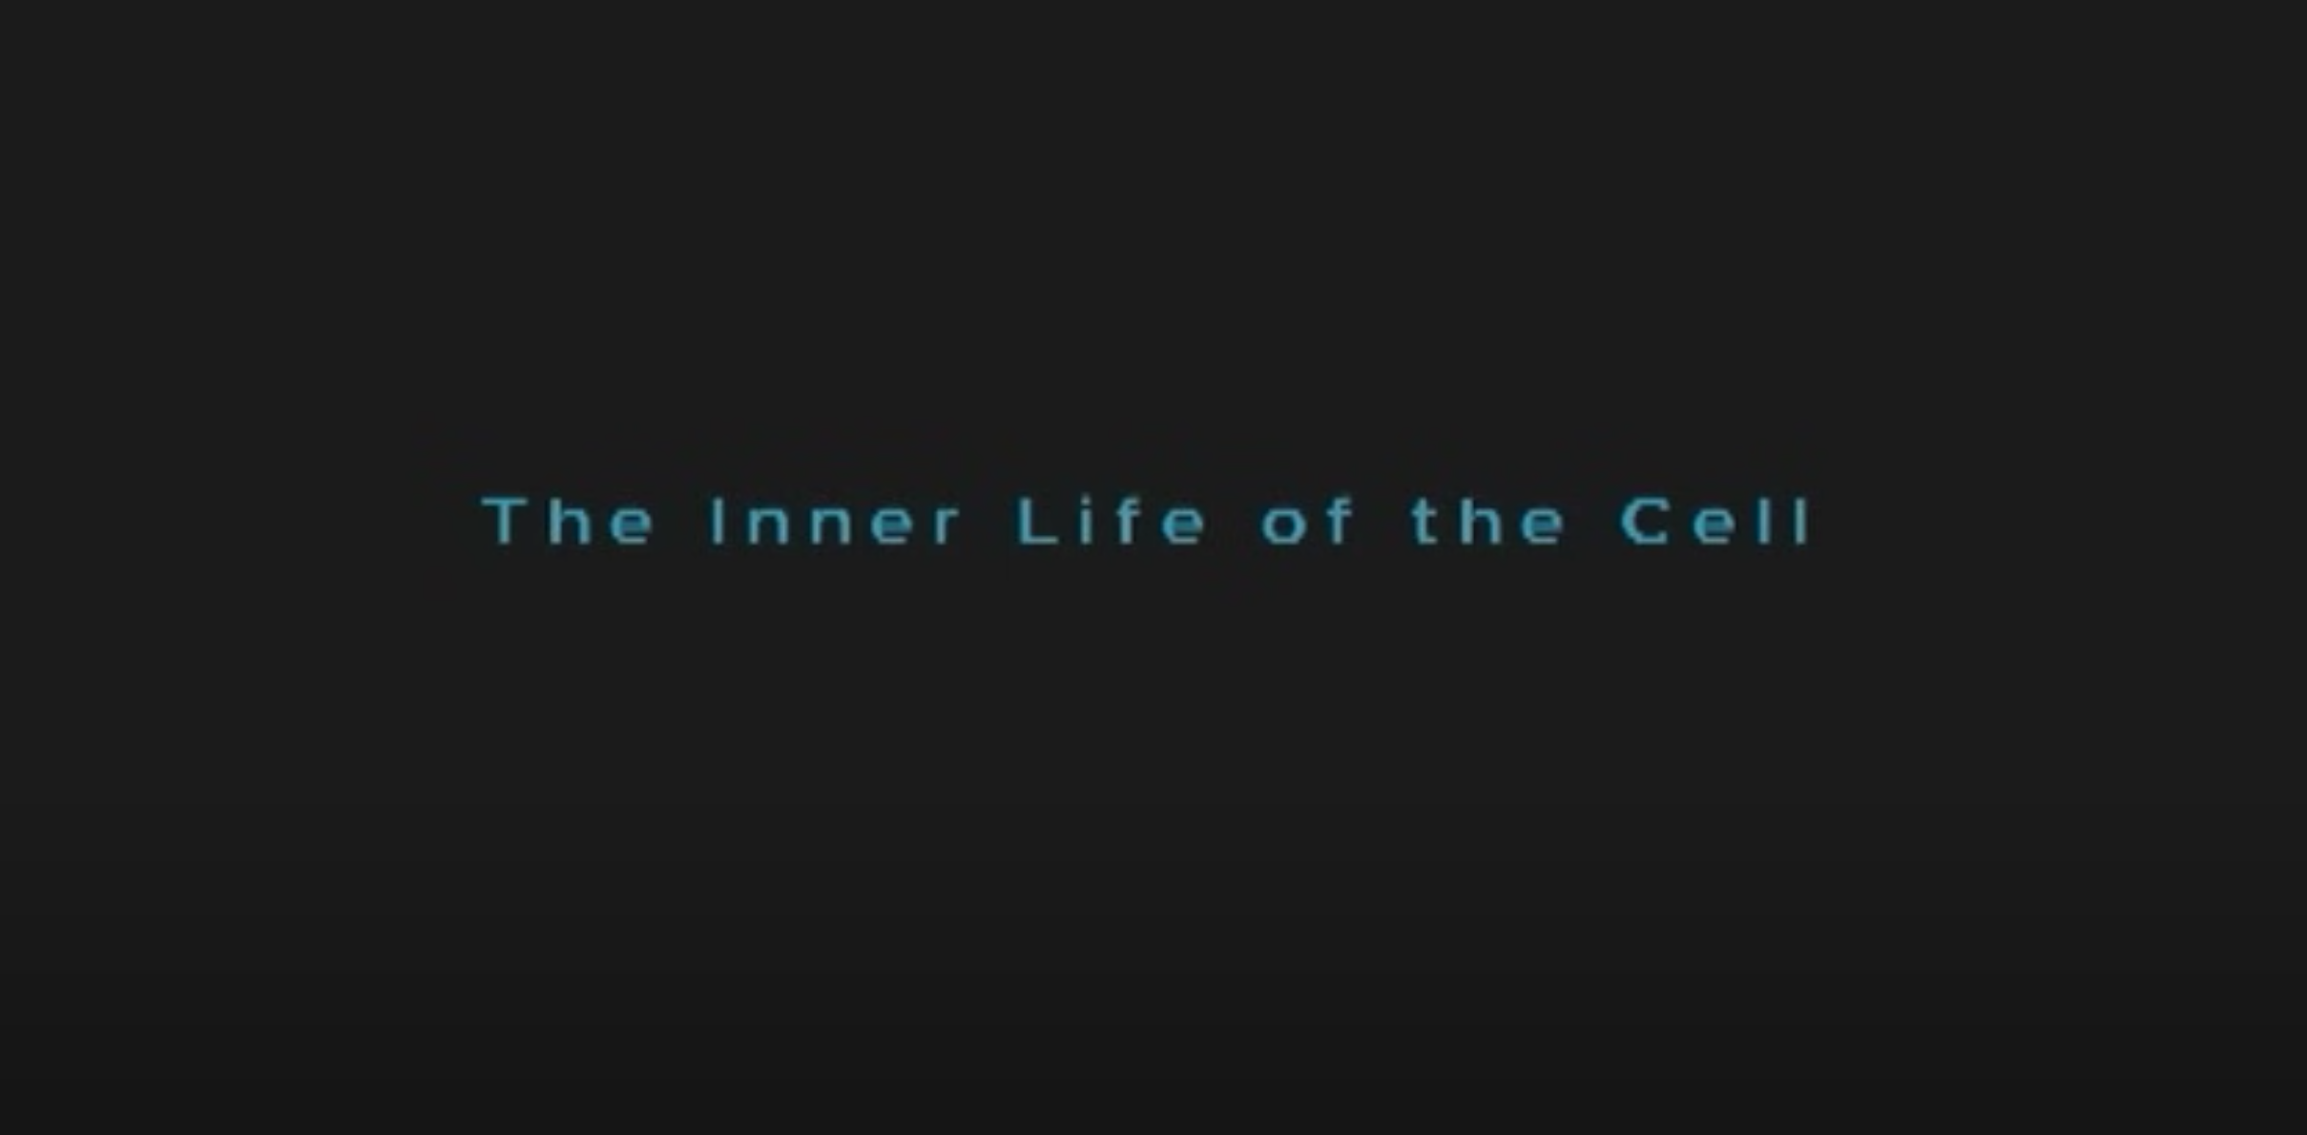

Slide 4
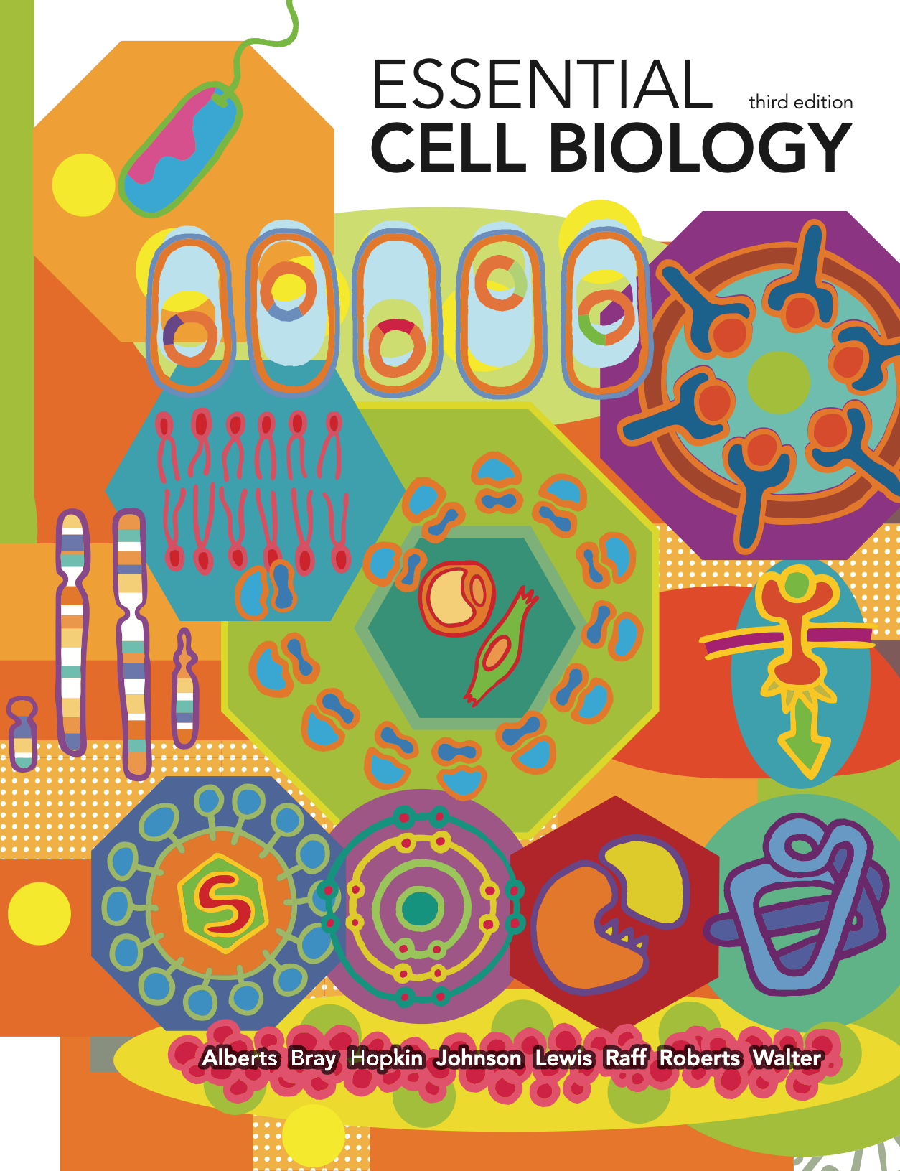
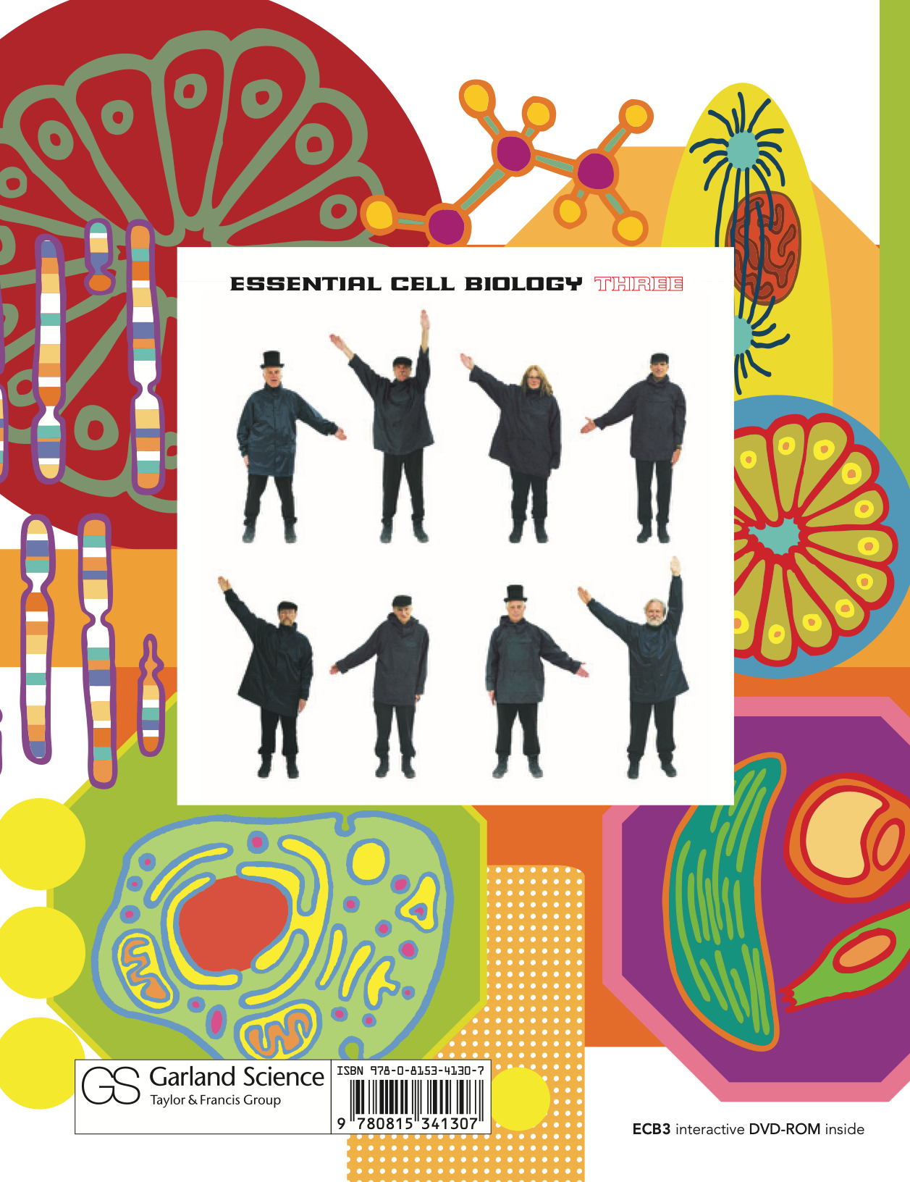
Syllabus

Slide 5
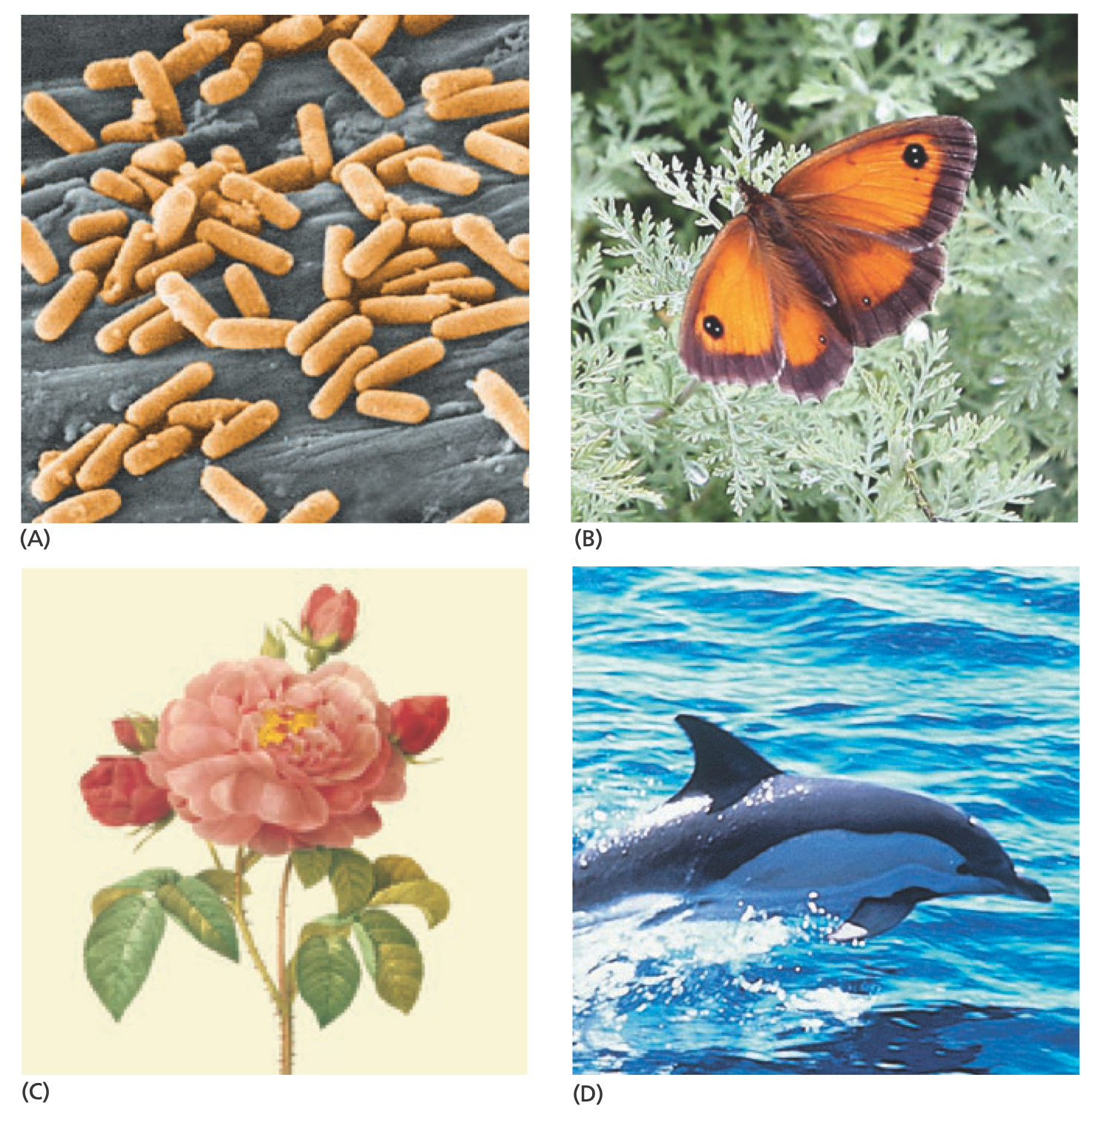
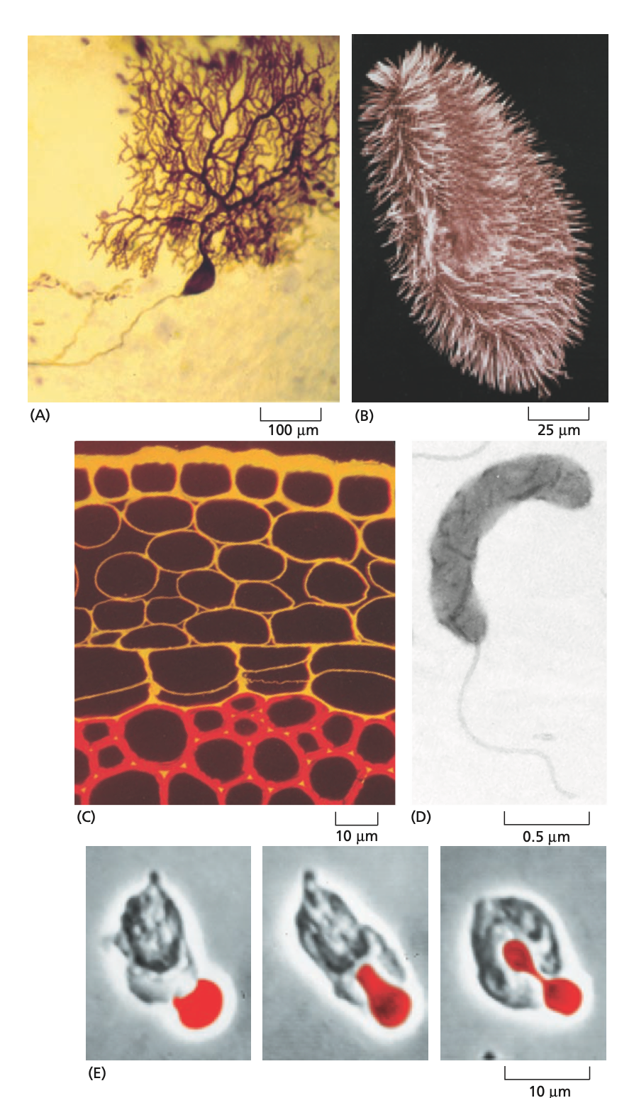
Cells
Notes:
Cells, A: Cerebellum Nerve, B: Paramecium, C: Section of young plant, Cellulose: Red, Pectin (Cell wall component): Orange, D: Bdellovibrio bacteriovorus (small bacterium) which attacks and kills and feeds by other bacteria, E: Human white blood cell captures red blood cell

Slide 6
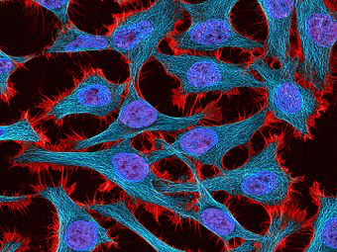
HeLa Cells
Notes:
The line was derived from cervical cancer cells taken on February 8, 1951 from Henrietta Lacks. Scientists have grown an estimated 20 tons of HeLa cells, and there are almost 11,000 patents involving these cells.

Slide 7
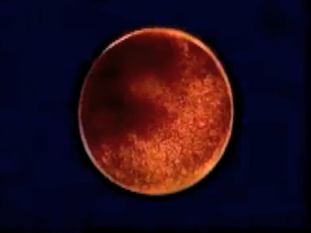
Cells in Embryos
Notes:
This frog egg cell has been fertilized and starts dividing. The first cell divisions occur very rapidly. Cells divide every thirty minutes. This timing is very precise. Egg cells that have been fertilized at the same time divide and develop in almost perfect synchrony. After a day or two, embryonic development is completed and tadpoles hatch from the eggs.

Slide 8
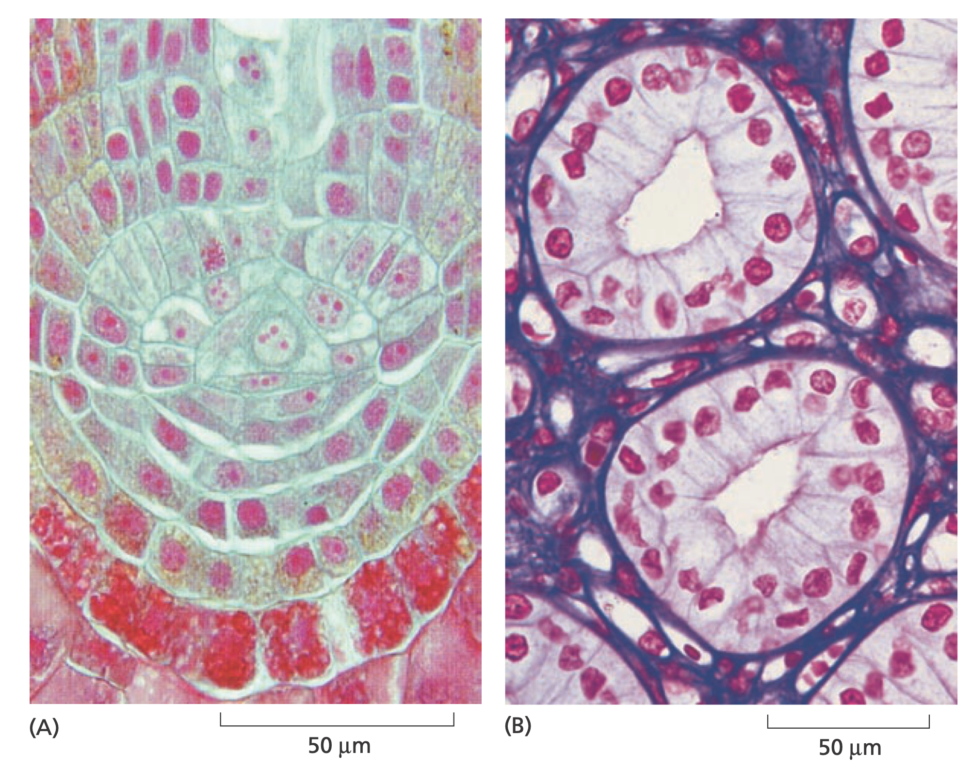
Tissues
Notes:
A: Root tip of fern (سرخس), nuclei: red, cell wall: blue
B: urine-collecting ducts of kidney, nuclei: red, extra-cellular matrix: purple

Slide 9
Life Kingdoms

Slide 10
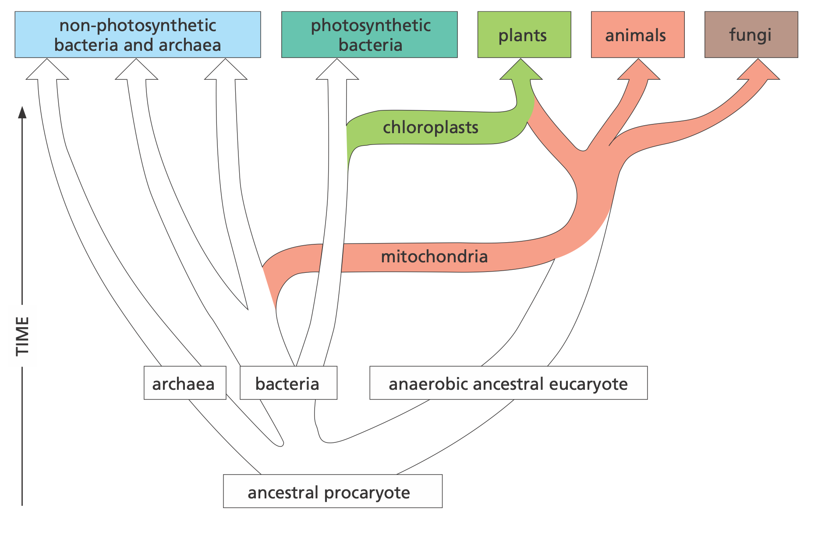

Kingdoms of Life
Procaryotes
Bacteria
Archaea
Eucaryotes
Animals
Plants
Fungi
Notes:
Archaea:live in concentrated brine, hot acid volcanic springs, in the airless depths of marine sediments, in the sludge of sewage treatment plants, in pools beneath the frozen surface of Antarctica, and in the acidic, oxygen-free environment of a cow’s stomach, where they break down cellulose and generate methane gas

Slide 11
Procaryotes
Mostly, single-celled organisms
Some join together to form chains or clusters
In shape and structure: simple and limited
In chemistry: Most diverse and inventive class
From hot puddles of volcanic muds, to interiors of other living cells

Slide 12
Procaryotes
Vastly outnumber other living organisms on Earth
Some are aerobic, using oxygen to oxidize food molecules
Some are strictly anaerobic and are killed by the slightest exposure to oxygen

Slide 13
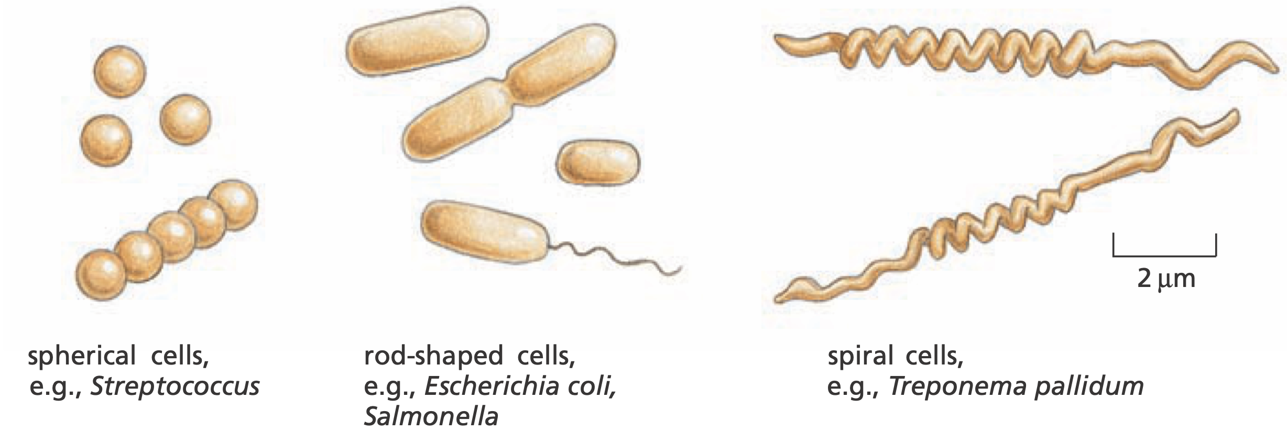
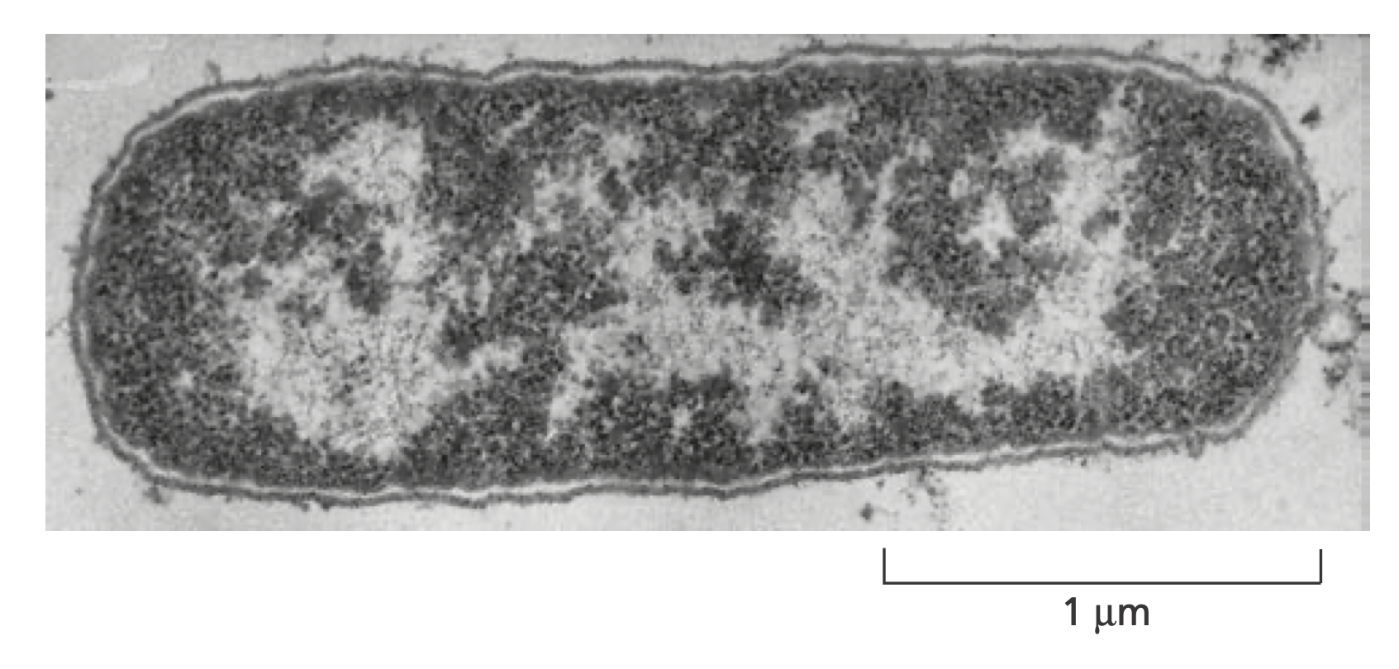
Shapes of Bacteria
Notes:
Escherichia coli (E. coli) is understood more thoroughly than any other living organism

Slide 14
Prokaryotic Metabolism
Virtually any organic material, from wood to petroleum, can be used as food by one sort of bacterium or another
Some procaryotes can live entirely on inorganic substances: CO2, N2, O2, H2, S and P from air, water and inorganic material

Slide 15
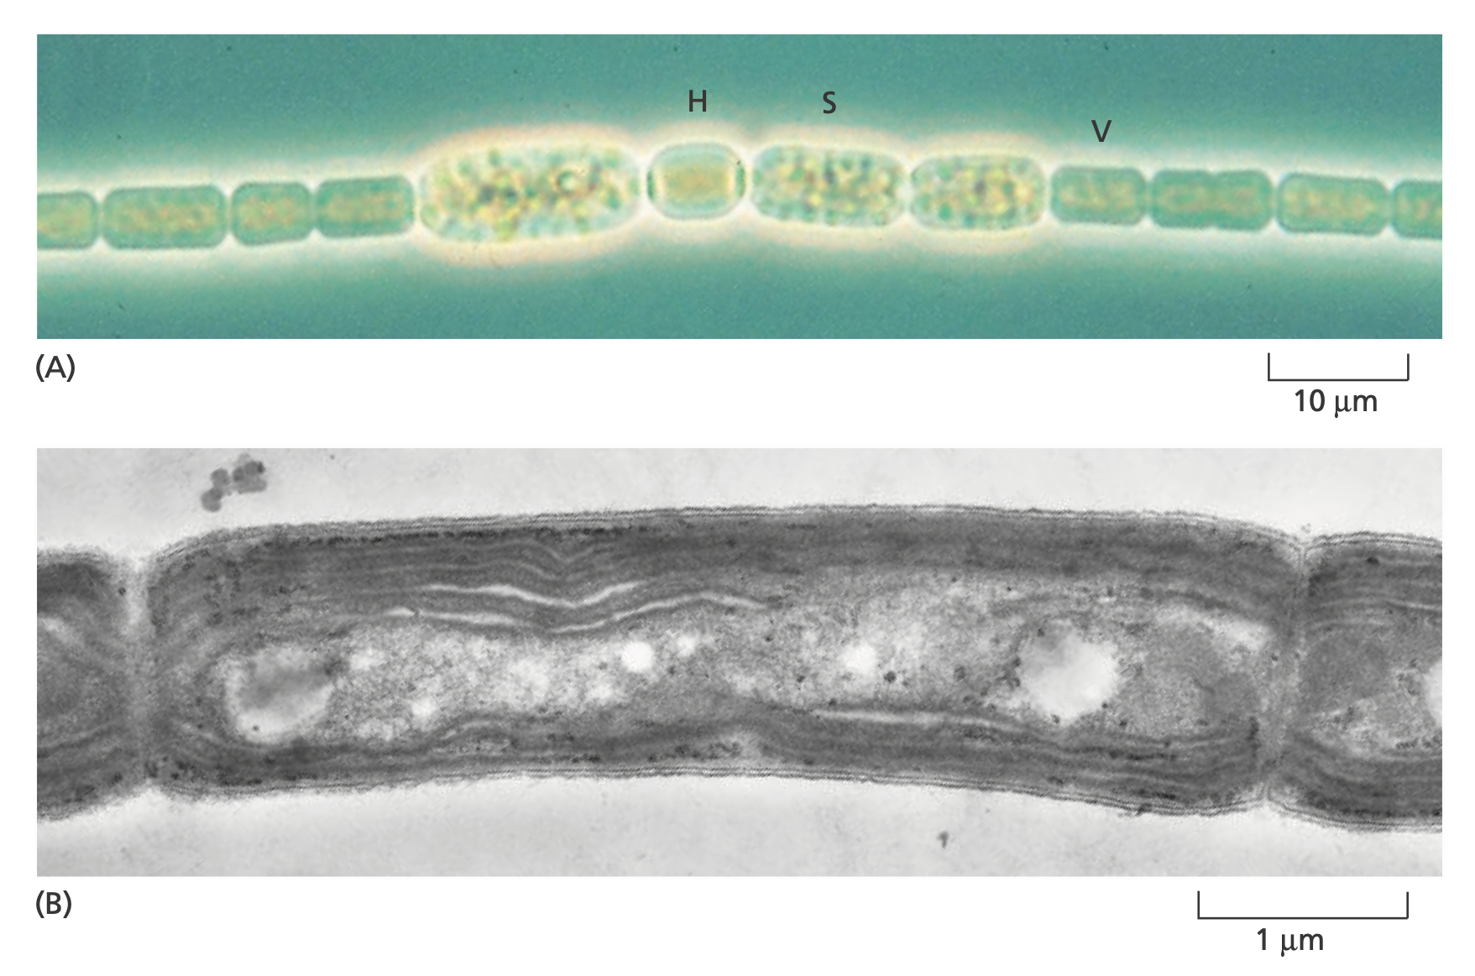
Prokaryotic Sources of Energy
Some do photosynthesis: getting energy from sunlight
Notes:
Up: Anabaena cylindrica either fix nitrogen (H), fix CO2 (through photosynthesis;V), or become resistant spores (S)
Down: Phormidium laminosum, shows the intracellular membranes where photosynthesis occurs.

Slide 16
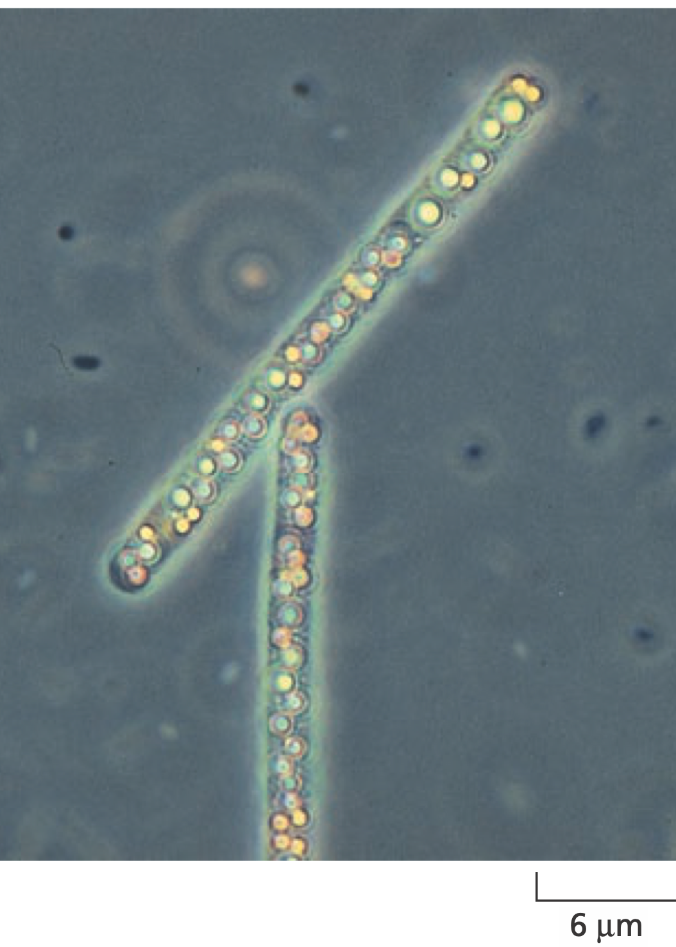
Prokaryotic Sources of Energy
Others derive energy from the chemical reactivity of inorganic substances in the environment
Notes:
Beggiatoa, a sulfur bacterium gets its energy from H2S
Yellow: deposits of sulfur

Slide 17
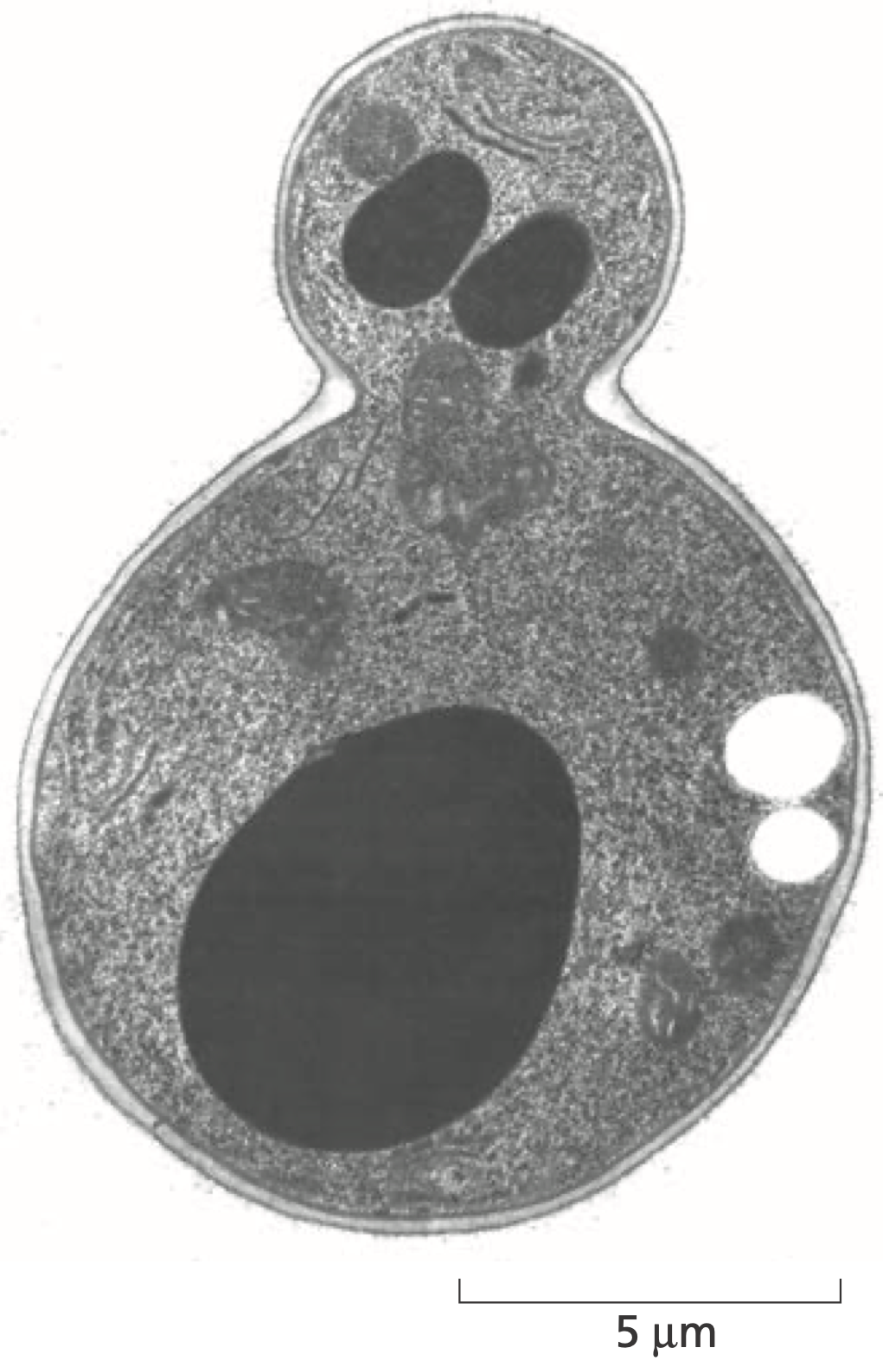
Eucaryotes
Eucaryotic cells, in general, are bigger and more elaborate than bacteria and archaea
Some live independent lives as single-celled organisms, such as amoebae and yeasts
Others live in multicellular assemblies

Slide 18
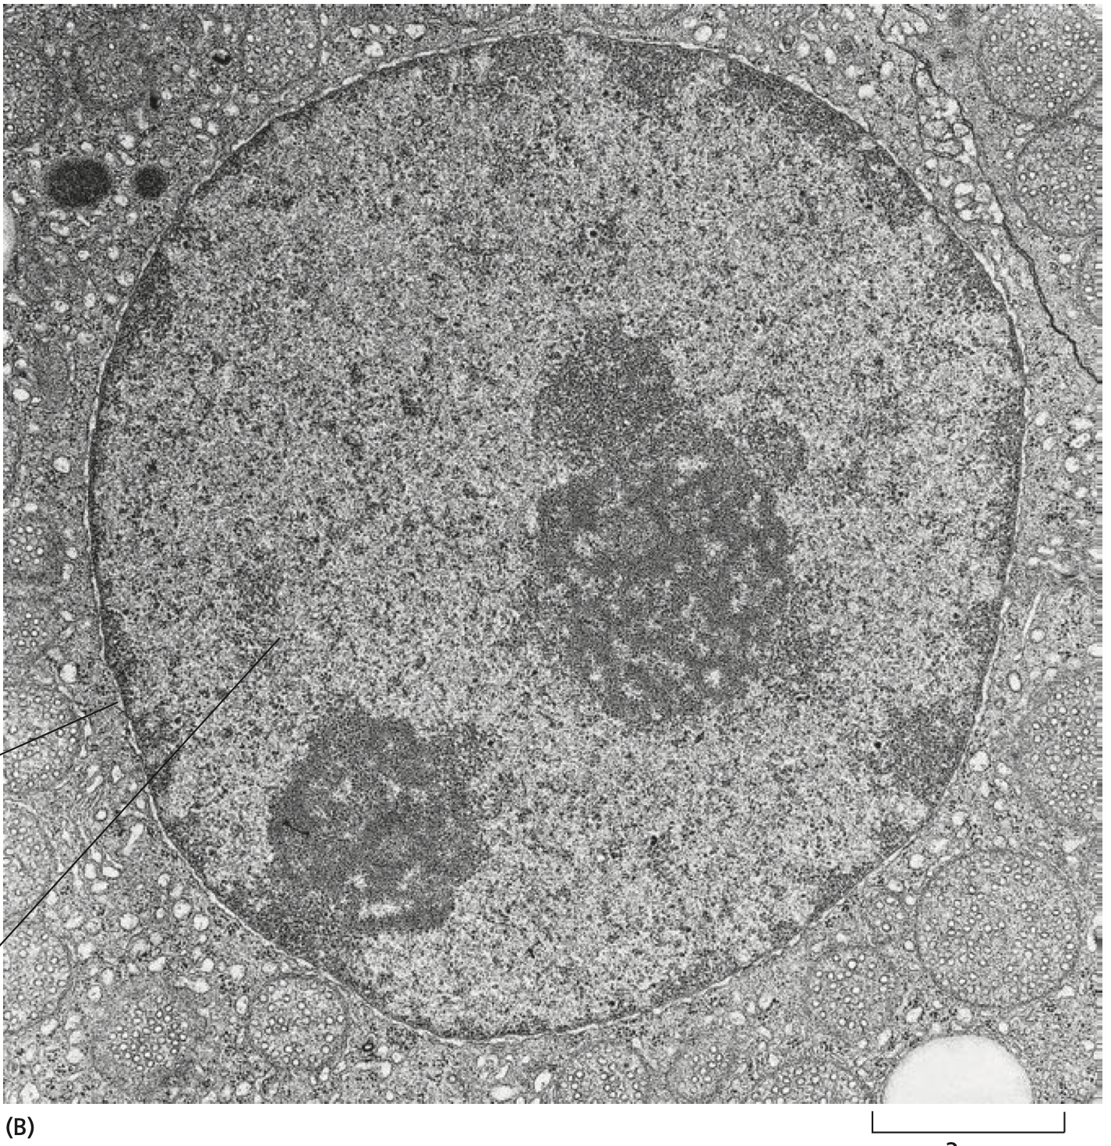
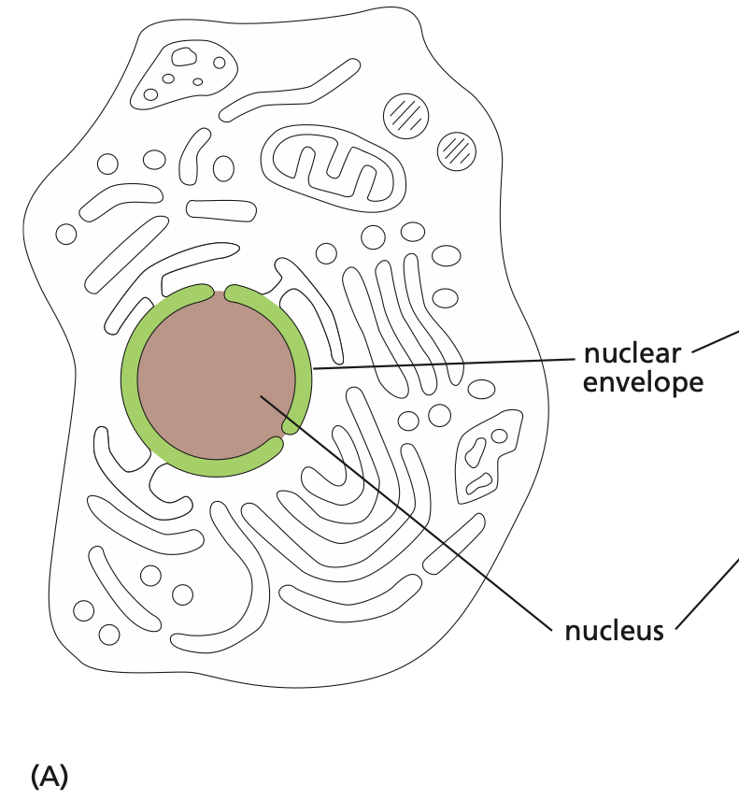
Nucleus: the information store of the Cell

Slide 19
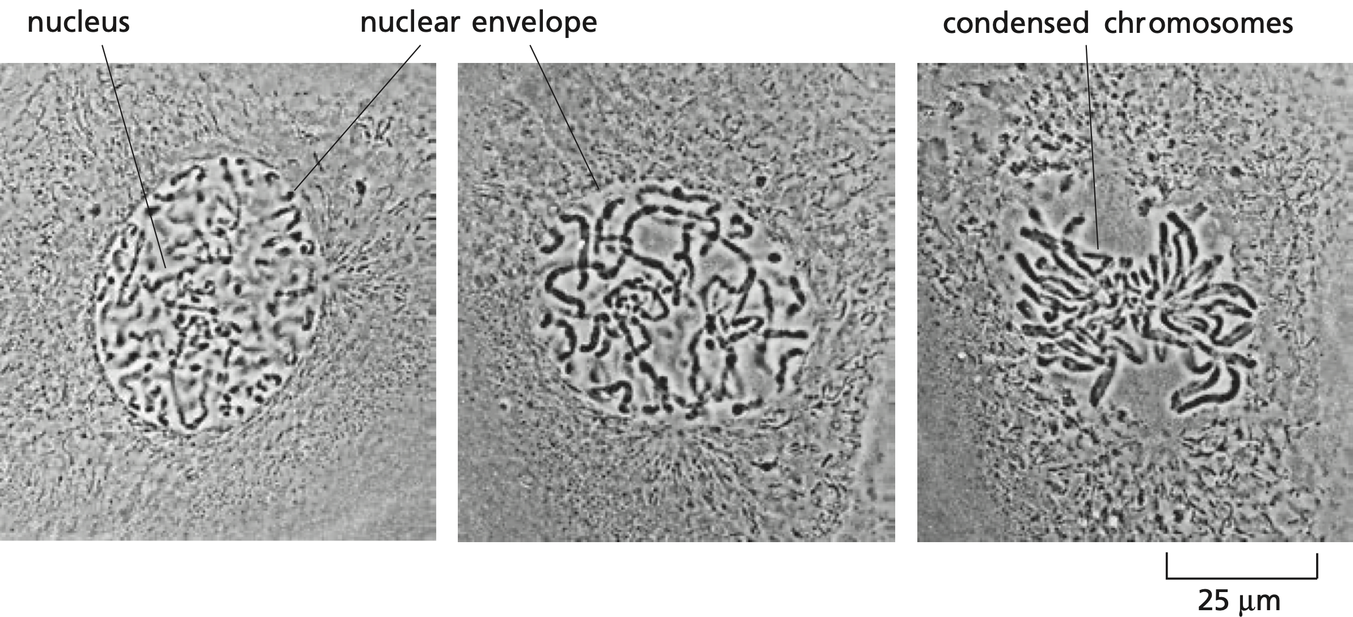
Nucleus
Notes:
Chromosomes become visible when a cell is about to divide. Procaryotes lack a distinct nucleus because DNA is not inside envelope

Slide 20
Mitochondria
Mitochondria generate usable energy from food to power the Cell
They are present in essentially all eucaryotic cells, and very visible
Mitochondria contain their own DNA and reproduce by dividing in two

Slide 21
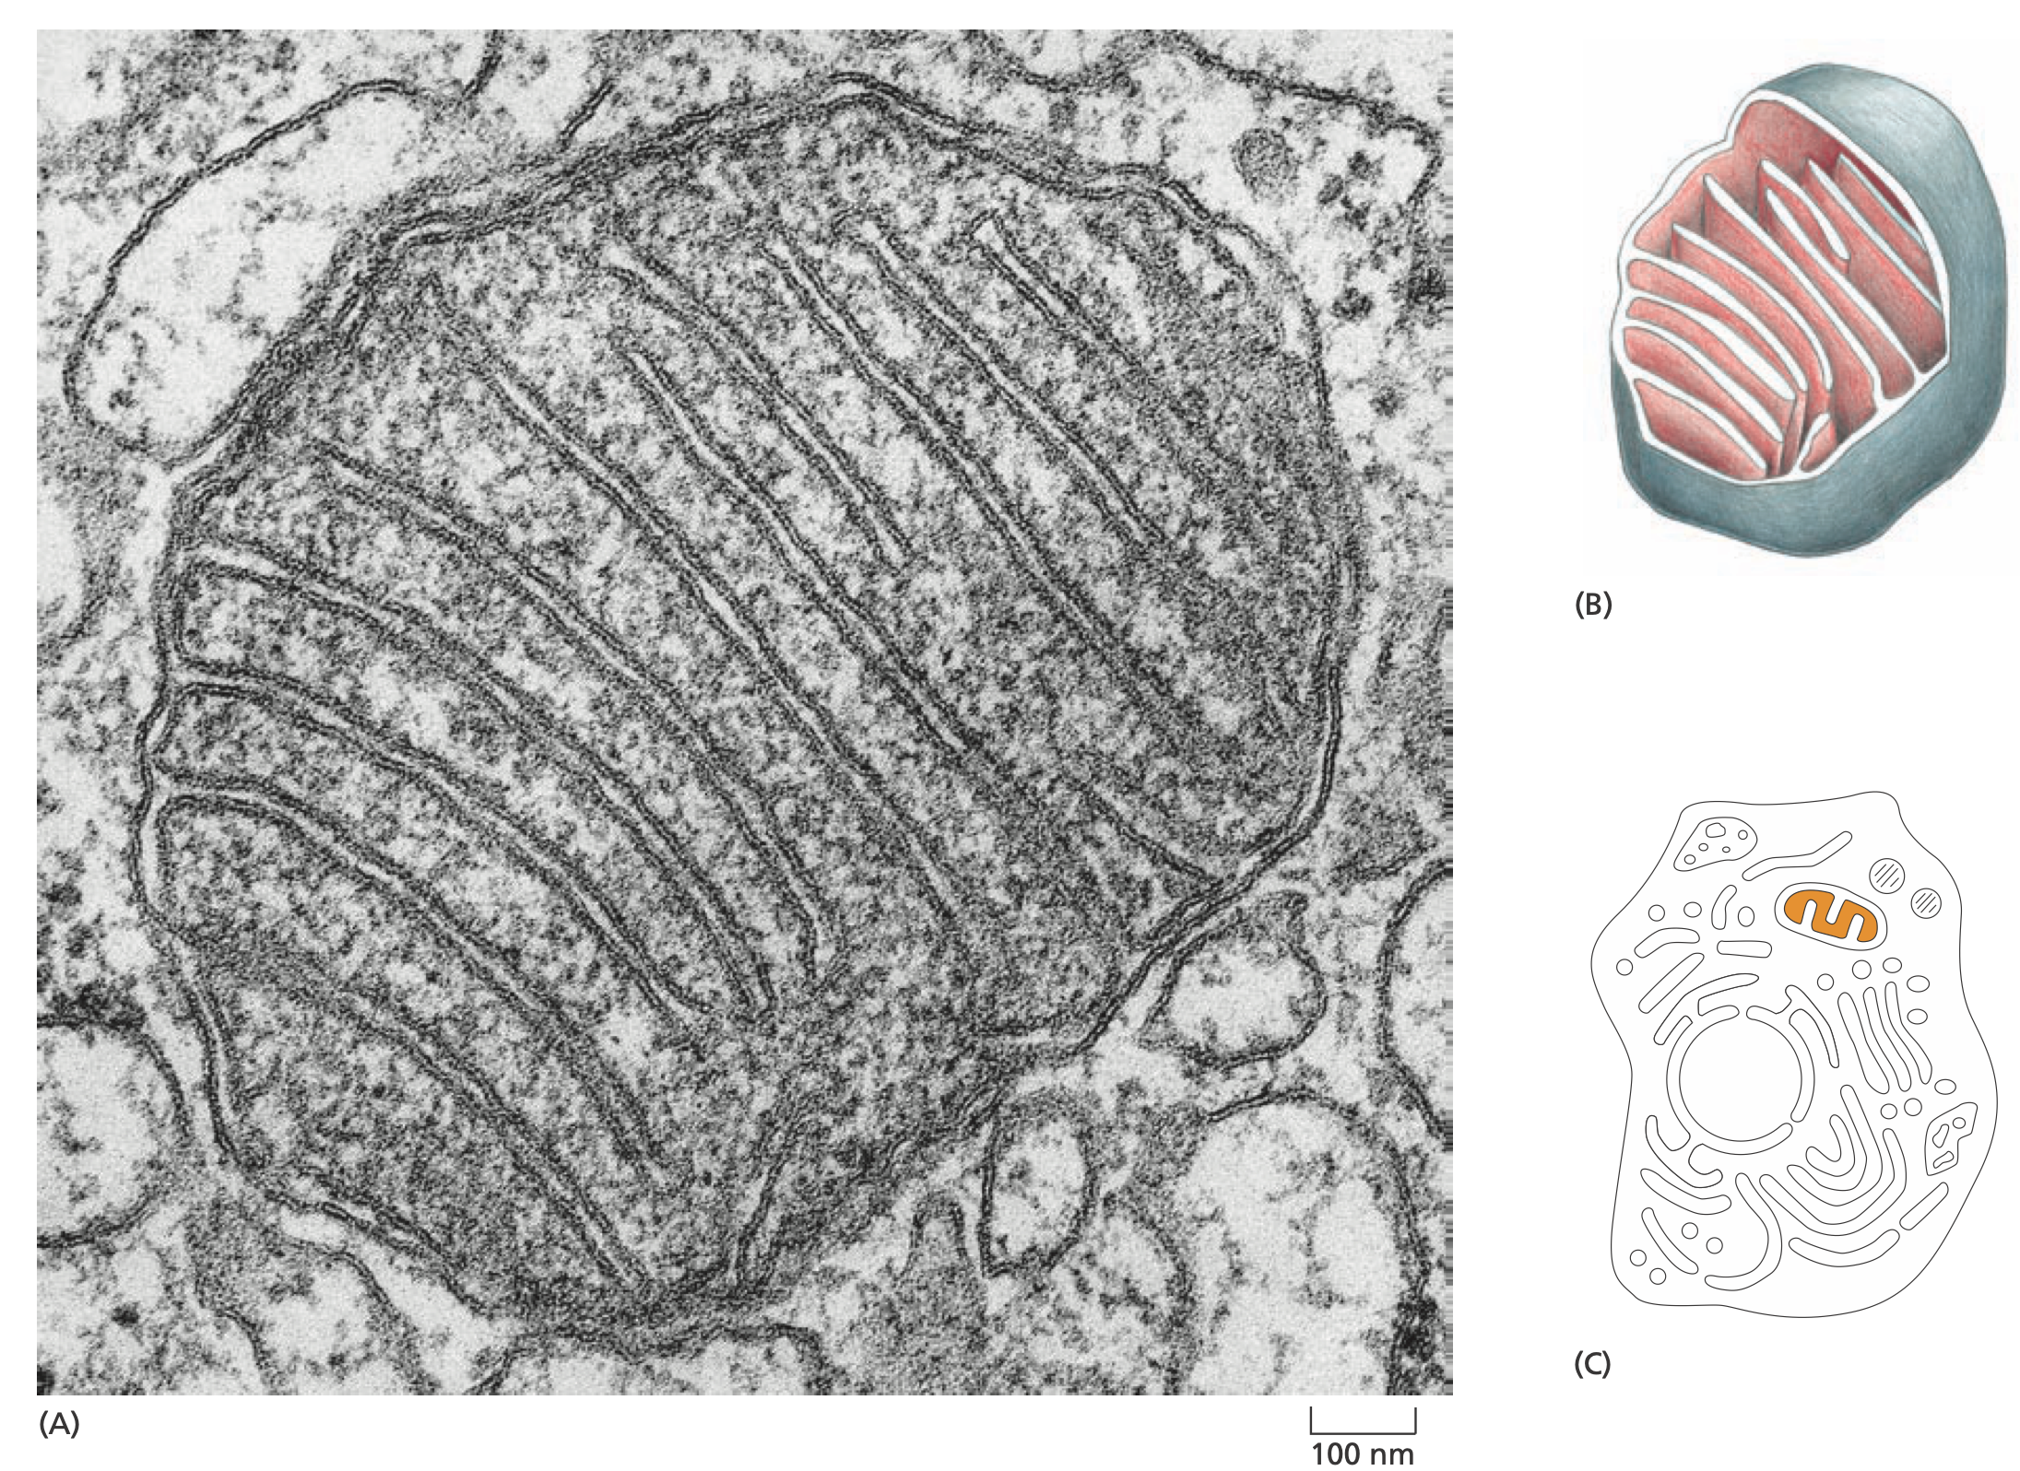
gtdt
Notes:
Worm shaped
Two separate membranes: smooth outer and highly convoluted inner
Inner: most of proteins of respiration

Slide 22
Mitochondria Function
Their function was discovered by breaking open cells and then spinning the soup of cell fragments in a centrifuge
This separates the organelles according to size, shape, density
Purified mitochondria were then tested to see what chemical processes they could perform
This revealed that mitochondria are generators of cell energy by oxidation of food to produce adenosine triphosphate, or ATP
Called cellular respiration since consumes O2 and releases CO2

Slide 23
Mitochondria Function
Without it, animals, fungi, and plants would be unable to use oxygen to extract the maximum amount of energy from food molecules
Oxygen would be a poison for them, they would be anaerobic
There are even a few anaerobic eucaryotes, such as the intestinal parasite Giardia, that lack mitochondria and live only in environments that are low in oxygen

Slide 24
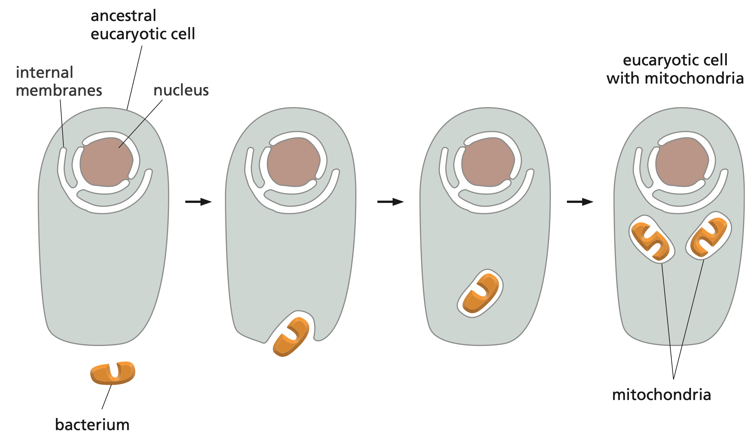
Mitochondria Origin

Slide 25
Chloroplasts
Chloroplasts capture energy directly from sunlight
The process is called photosynthesis
Large green organelles that are found only in the cells of plants and algae
Animals can only consume chemical energy from products of other living things
More complex structure than mitochondria: two surrounding membranes and internal stacks of membranes containing the green pigment chlorophyll

Slide 26
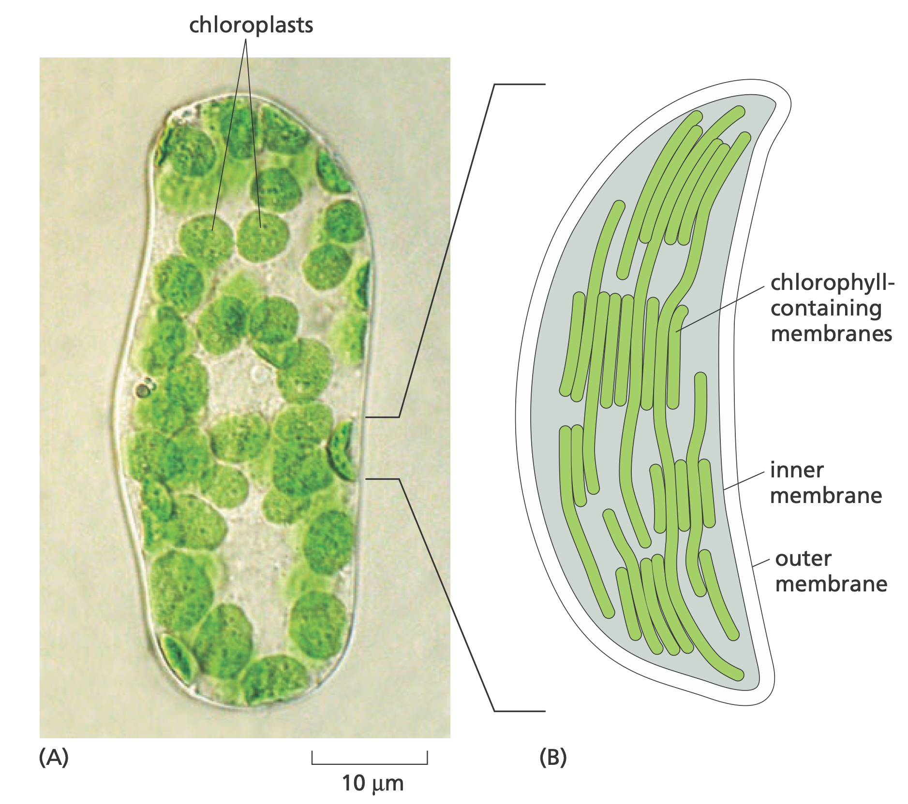
Chloroplasts

Slide 27
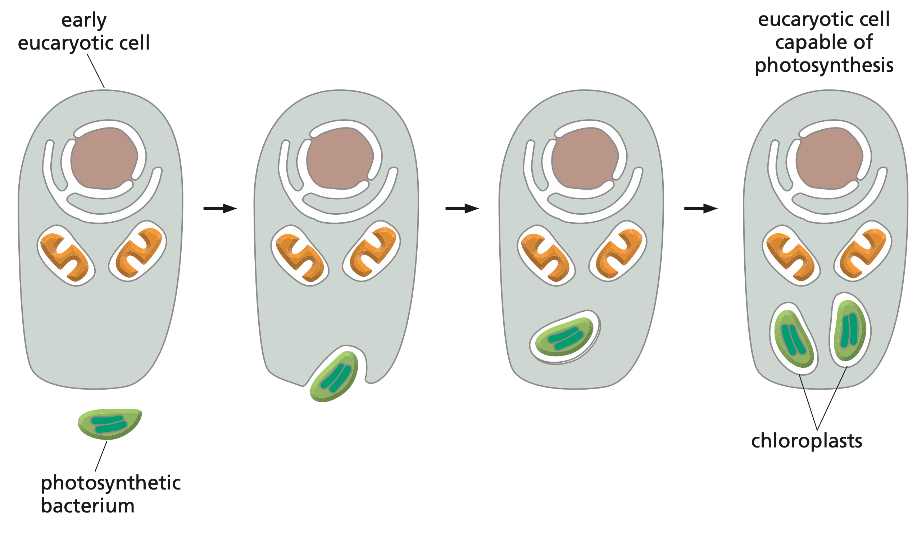
Chloroplast Origin

Slide 28
Other Organelles
Cytoplasm contains many other organelles, mostly surrounded by single membranes, with many distinct functions
Some are involved with the cell’s ability to import raw materials and to export manufactured substances and waste products
Some are enormously enlarged and specialized for the secretion of proteins
Others are plentiful in cells specialized for the digestion of foreign bodies

Slide 29
Endoplasmic Reticulum
An irregular maze of interconnected spaces enclosed by a membrane
The site where most cell membrane components and materials destined for export are made
Hosts ribosomes: the protein synthesis unit of cells
Because of its appearance, ribosome-coated ER is often called rough ER

Slide 30
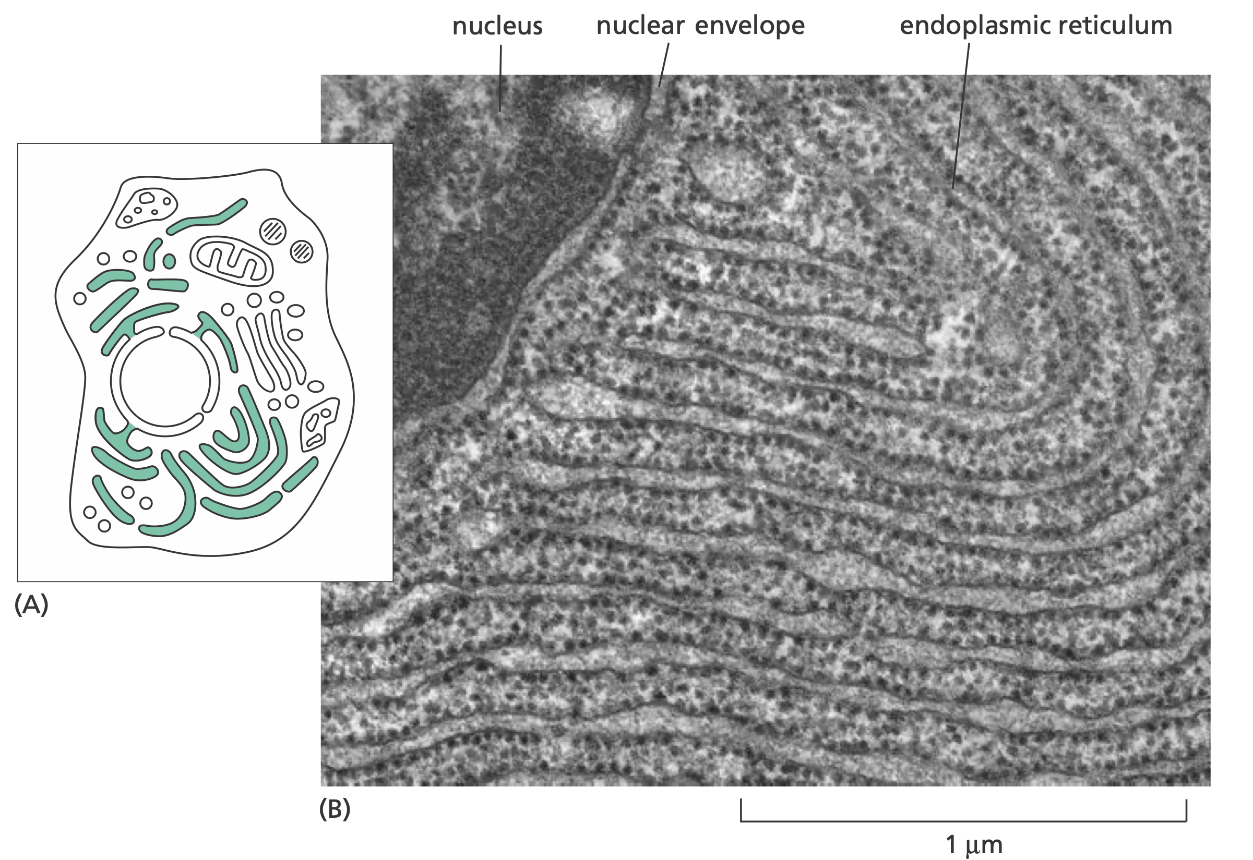
Endoplasmic Reticulum
Notes:
Pancreatic cell ER, specialised for protein secretion
ER is continuous with nuclear envelope membrane
Black particles: Ribosomes

Slide 31
Golgi Apparatus
Stacks of flattened membrane-enclosed sacs
Receives and often chemically modifies the molecules made in the endoplasmic reticulum
Then directs them to the exterior of the cell or to various locations inside the cell

Slide 32
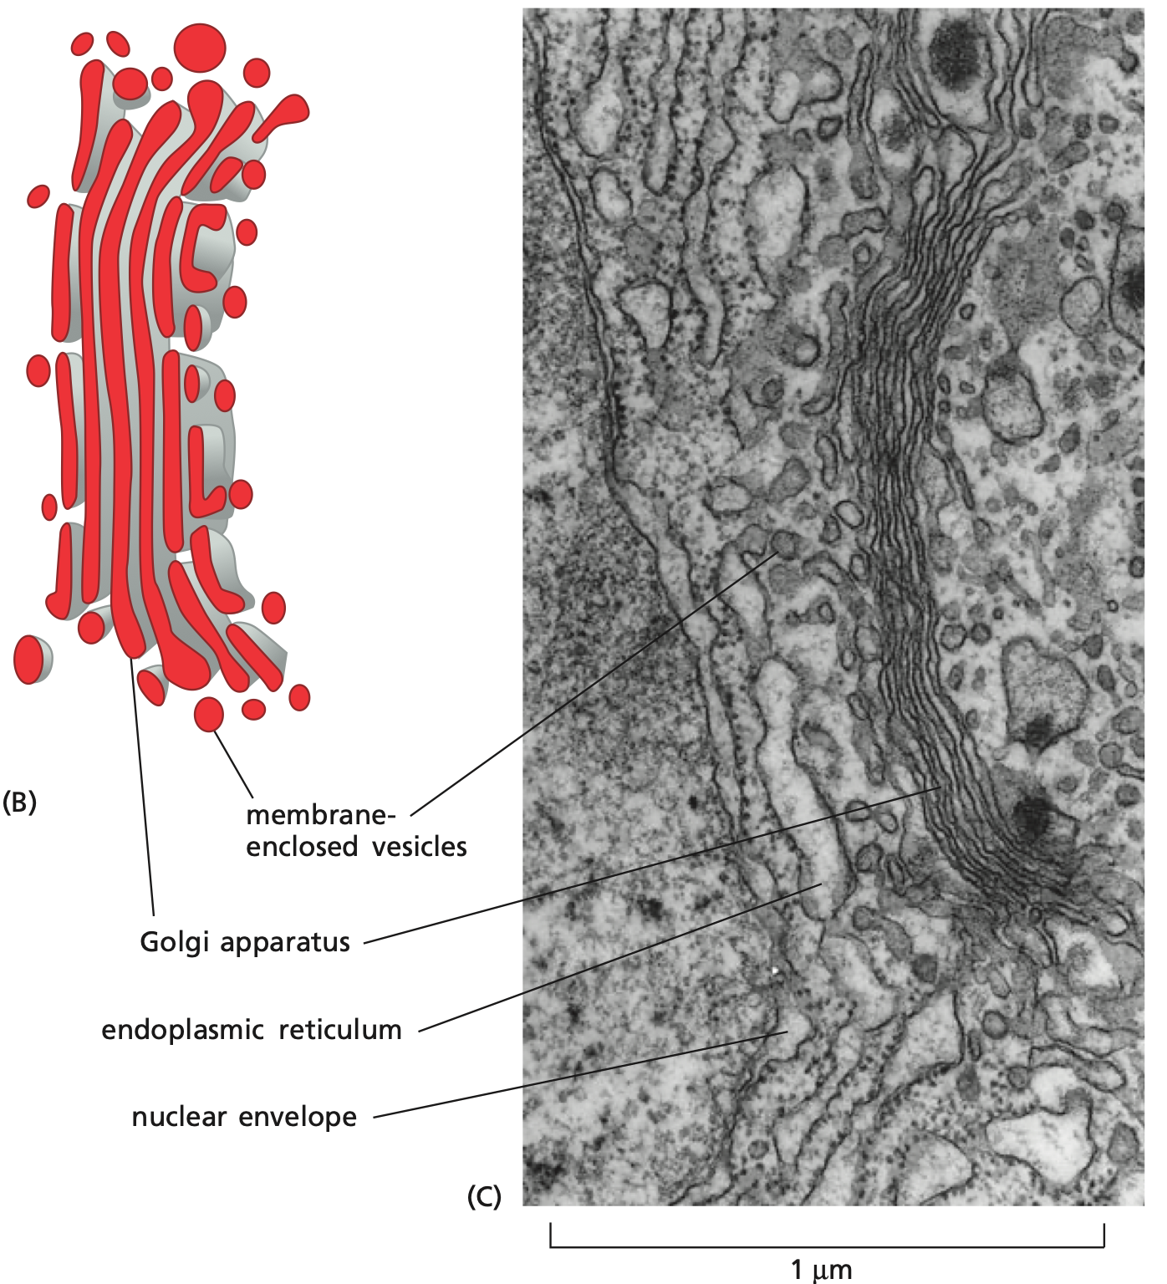
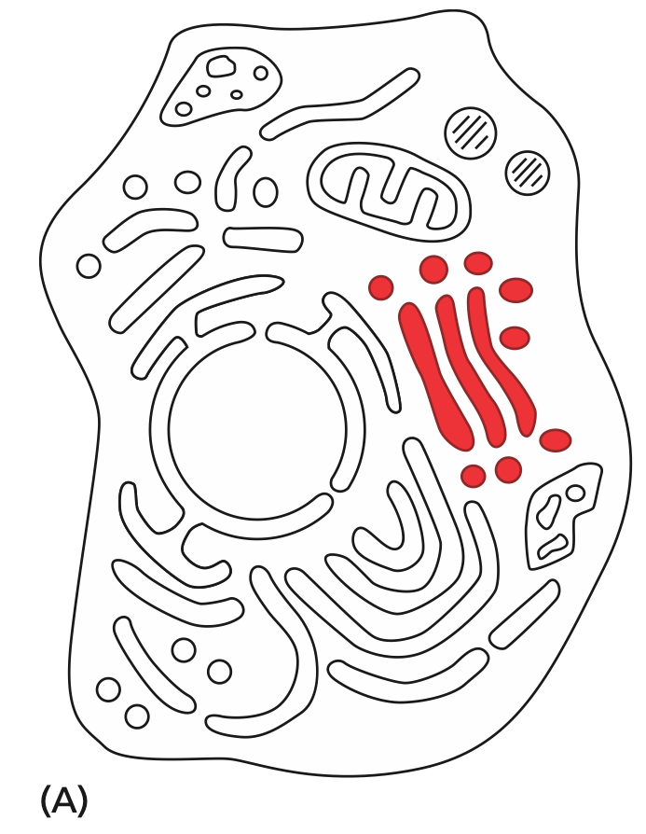
Golgi Apparatus
Notes:
Many small vesicles are seen nearby; some of these have pinched off from the Golgi stack, while others are destined to fuse with it.
A cell can have several Golgi apparatus

Slide 33
Lysosomes & Peroxisomes
Lysosomes are small, irregularly shaped organelles
Intracellular digestion occurs in lysosomes, releasing nutrients from food particles and breaking down unwanted molecules for recycling or excretion
Peroxisomes are small, membrane-enclosed vesicles
They provide a contained environment for reactions in which hydrogen peroxide, a dangerously reactive chemical, is generated and degraded

Slide 34
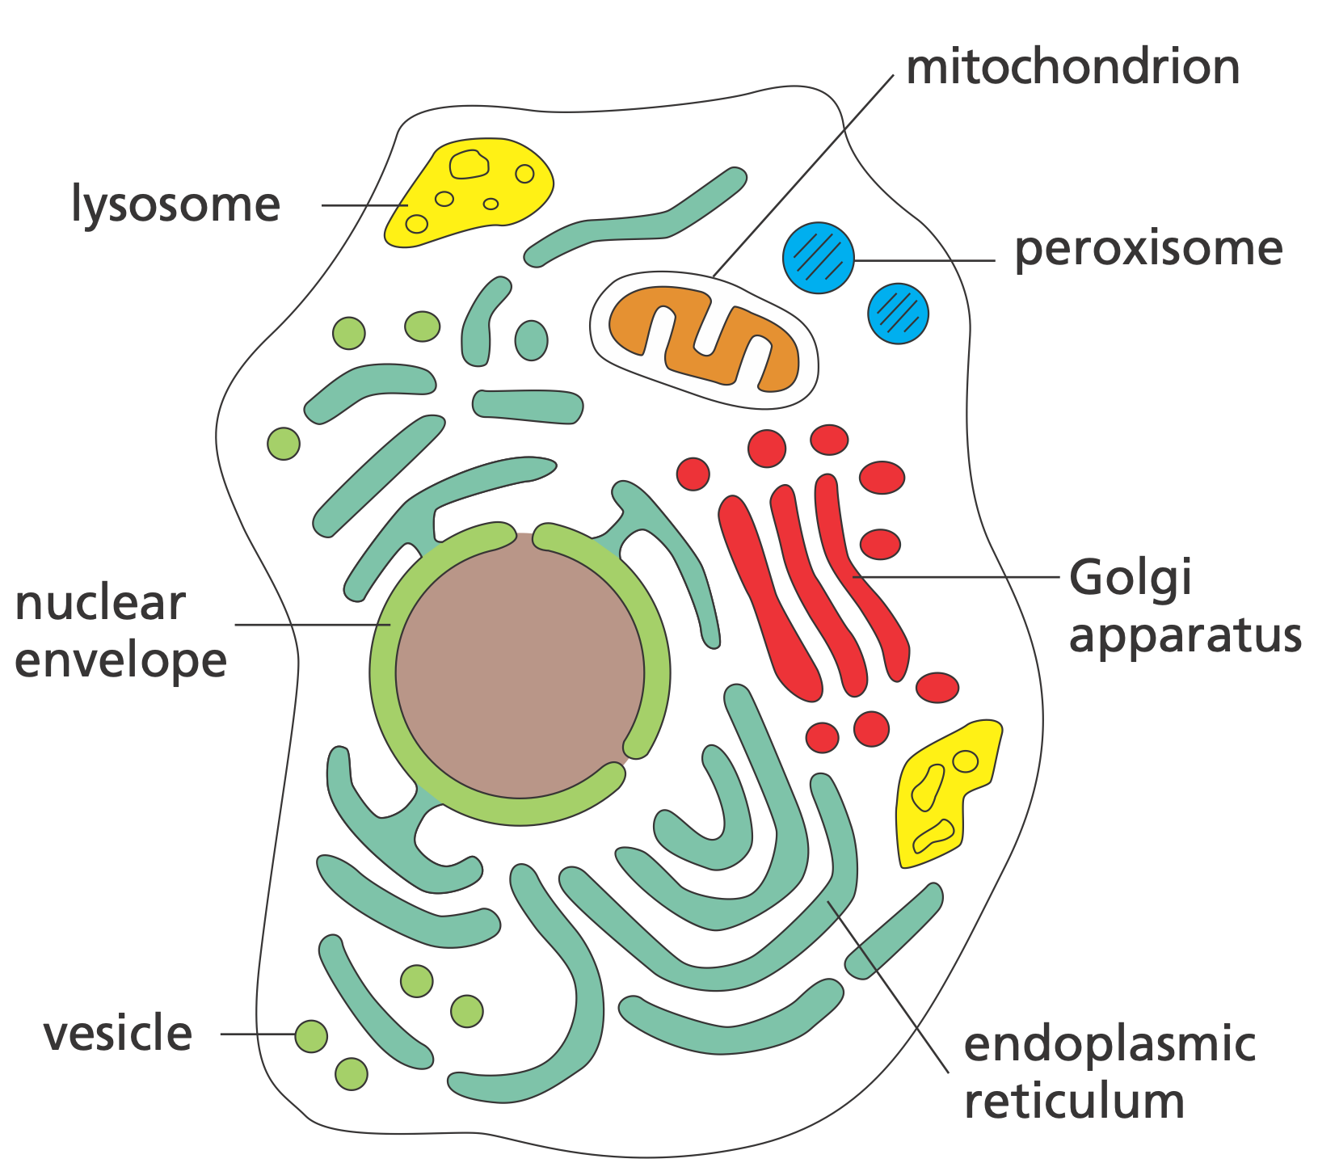
Organelles

Slide 35
Vesicles
Membranes form many different types of small vesicles
They are involved in the transport of materials between one membrane-enclosed organelle and another, or with outside of the cell
They pinch off from the membrane of one organelle and fuse with another, like tiny soap bubbles budding from and rejoining larger bubbles

Slide 36
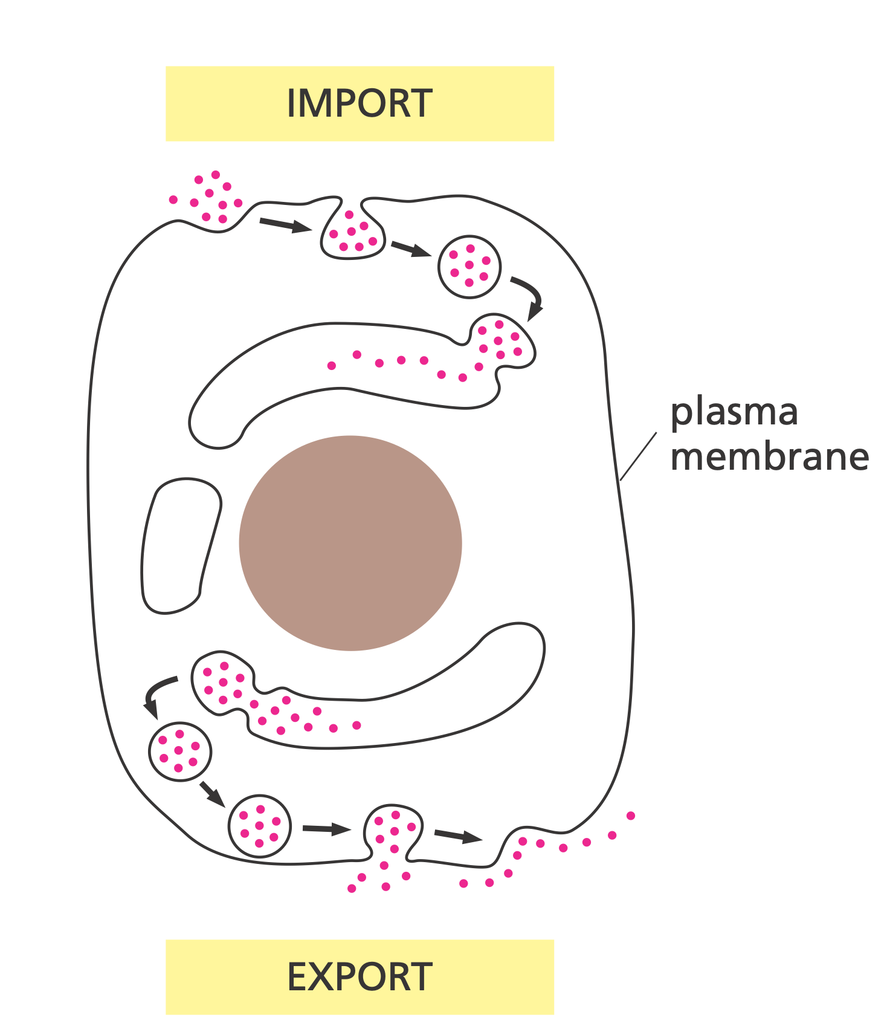
Vesicles

Slide 37
Endocytosis & Exocytosis
Vesicles can import external material and fuse with membrane-enclosed endosomes, which mature into lysosomes, where the imported material is digested
Animal cells can engulf very large particles, or even entire foreign cells, by this process of endocytosis
The reverse process, exocytosis is also a common cellular activity, mediated by exosomes, for releasing hormones, neurotransmitters, and other signaling molecules

Slide 38
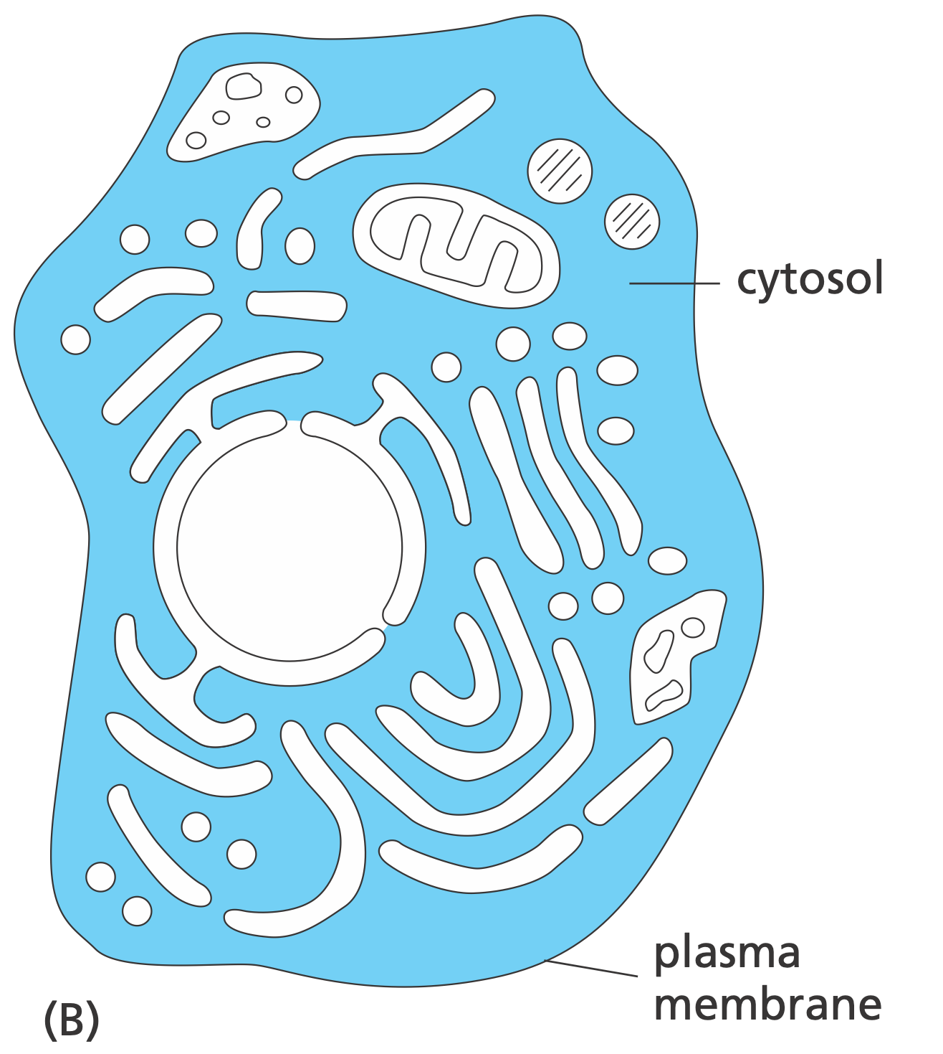
Cytosol

Slide 39
Cytosol
Cytosol is the part of the cytoplasm that is not partitioned off within intracellular membranes
In most cells, the largest single compartment, a host of large and small molecules, crowded together which makes it more like a water-based gel than a liquid solution
Site of many chemical reactions, such as breakdown of nutrient molecules, and manufacture of proteins
Ribosomes, the molecular machines that make the protein molecules, often attached to the cytosolic face of the endoplasmic reticulum

Slide 40
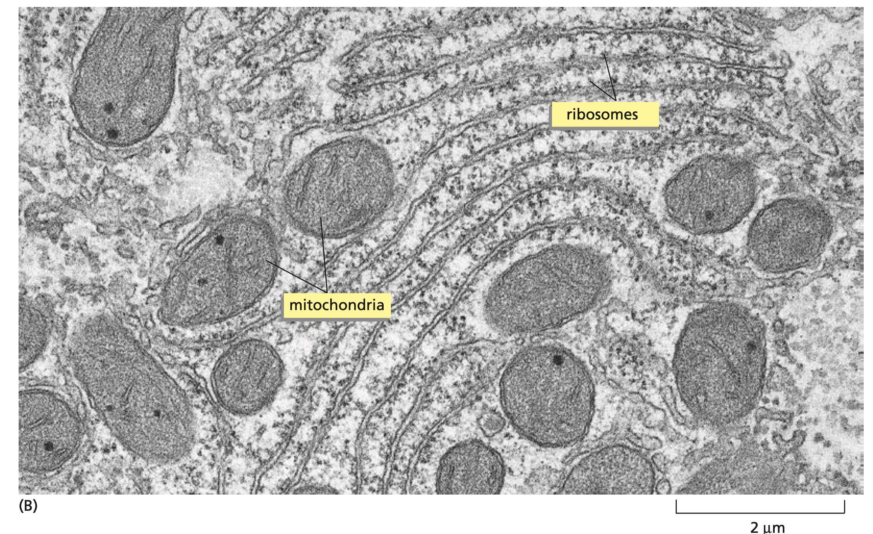
Ribosomes in Cytosol

Slide 41
Cytoskeleton
Cytoplasm is not just a structureless soup of chemicals and organelles
Cytosol is criss-crossed by long, fine filaments of protein. They anchor at one end to the plasma membrane or to radiate out from a central site adjacent to the nucleus
Cytoskeleton is responsible for directed cell movements

Slide 42
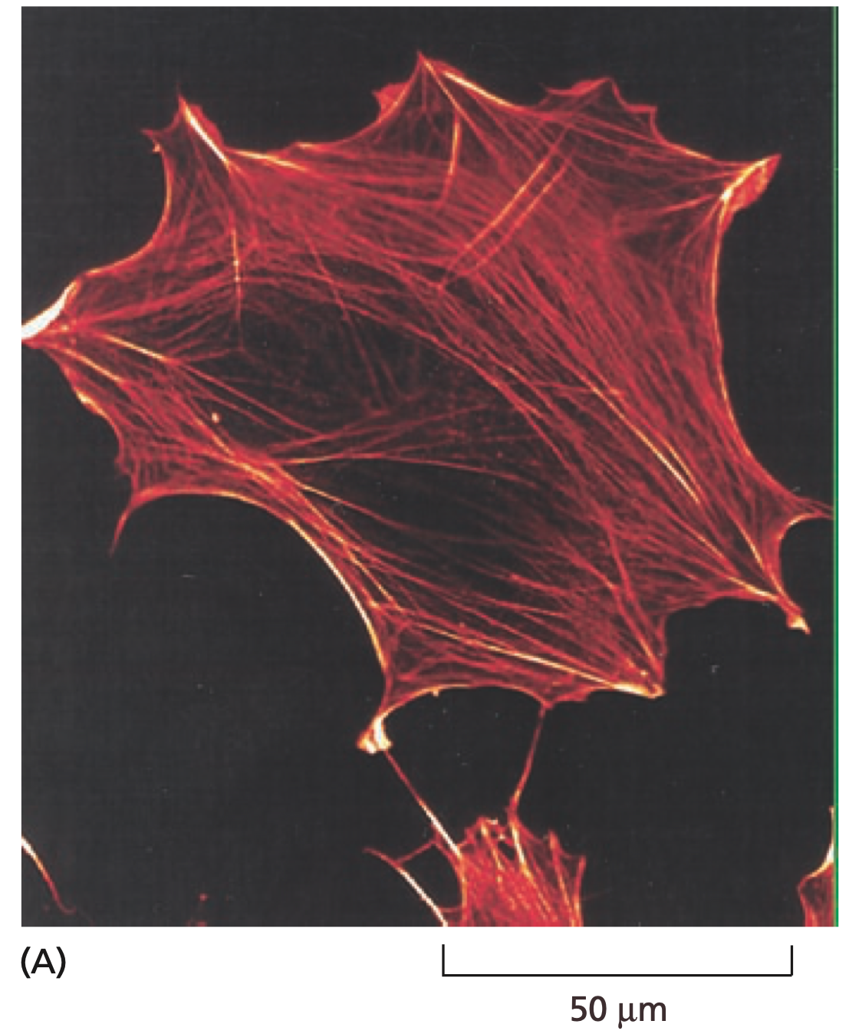
Actin filaments
The thinnest filaments
Present in all eukaryotic cells
Large number inside muscle cells
Part of the machinery that generates contractile forces

Slide 43
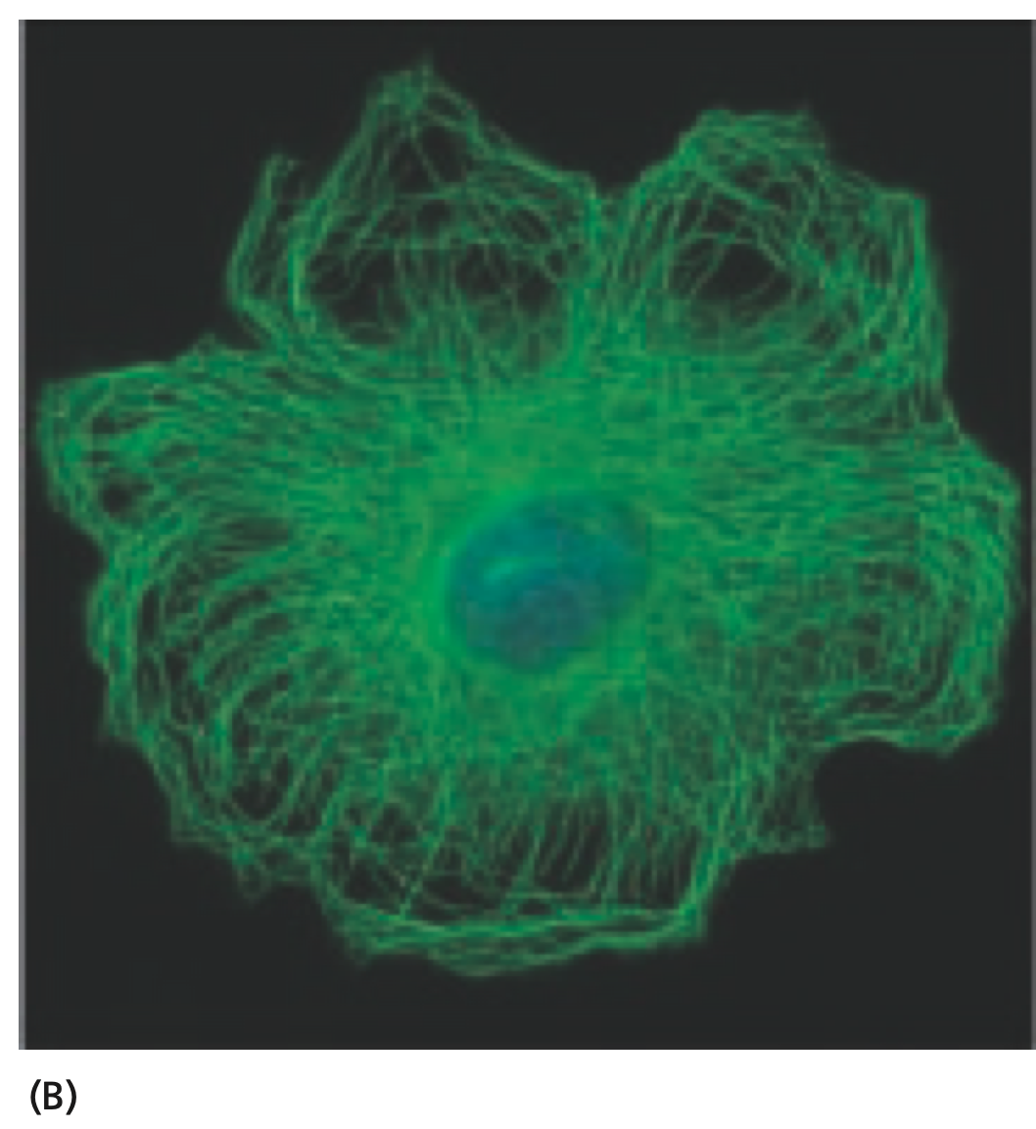
Microtubules
The thickest filaments
Minute hollow tubes
In dividing cells they form a spectacular array that helps pull the duplicated chromosomes in opposite directions and distribute them equally to the two daughter cells

Slide 44
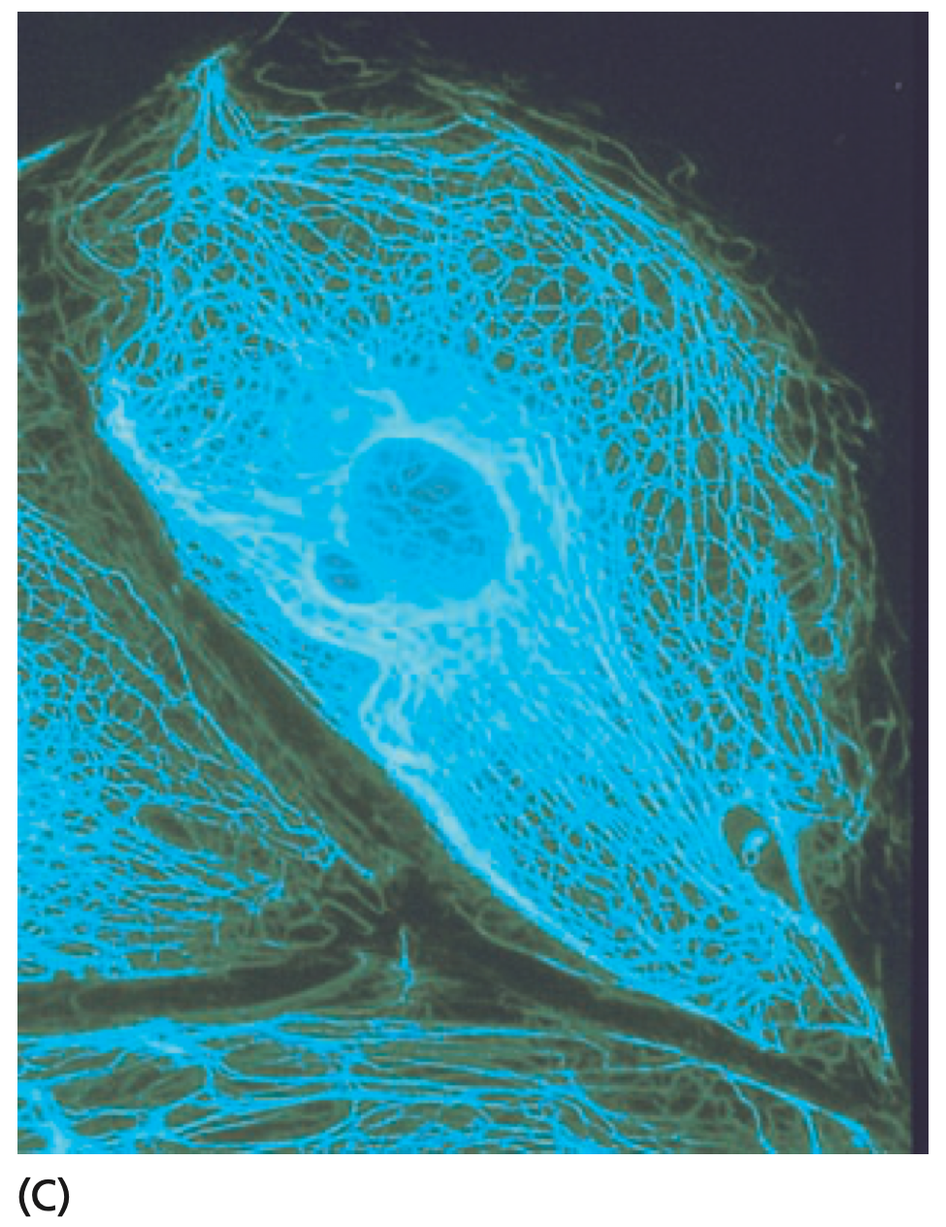
Intermediate filaments
Strengthen the cell mechanically
Actin & intermediate filaments and microtubules, together with other proteins that attach to them, form a system of girders, ropes, and motors that gives the cell its mechanical strength, controls its shape, and drives and guides its movements

Slide 45
How to see cells?

Slide 46
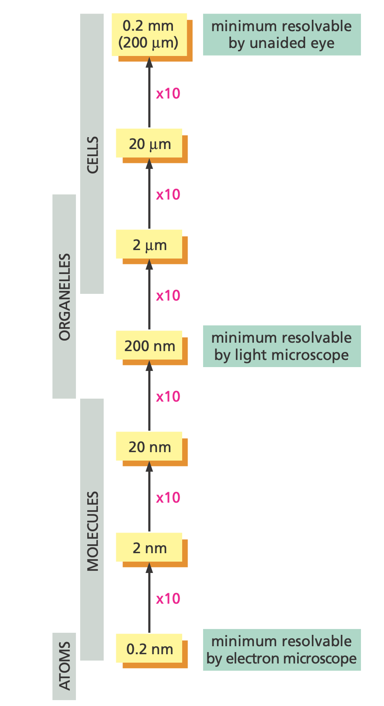
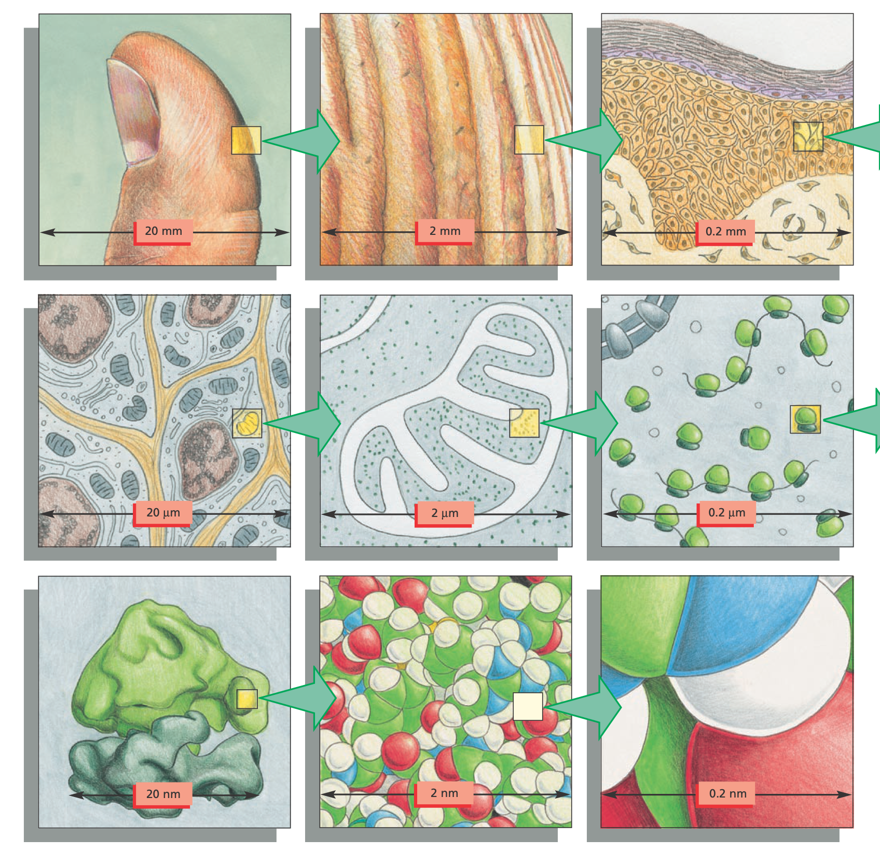
What can we see?

Slide 47
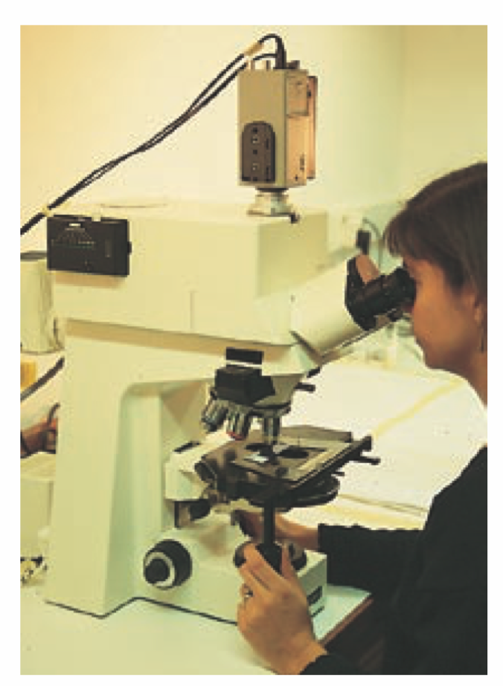
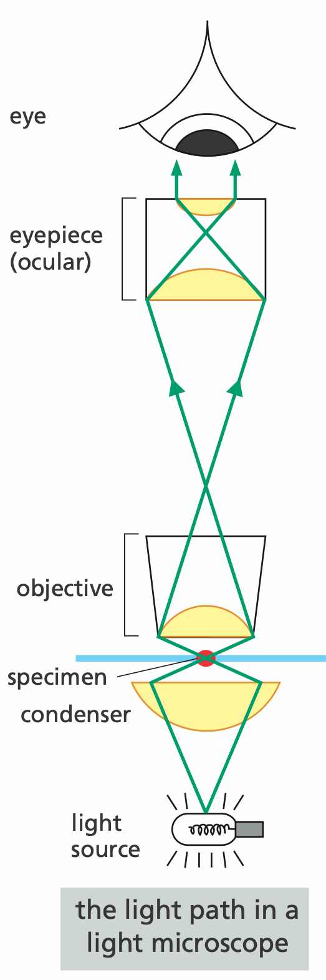
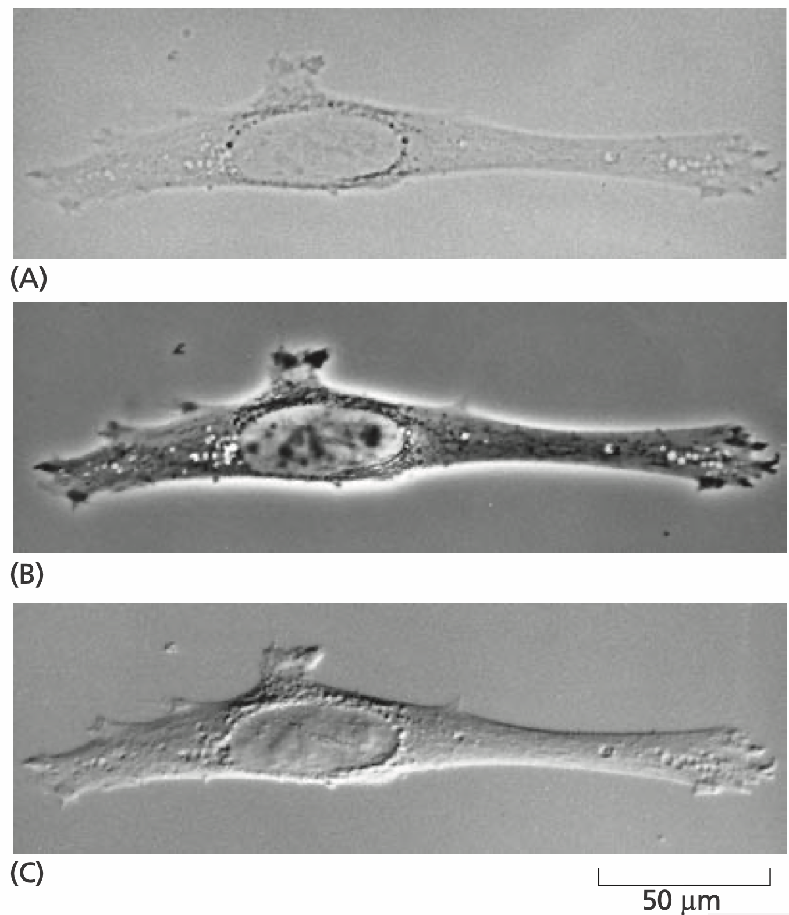
Light Microscope

Slide 48
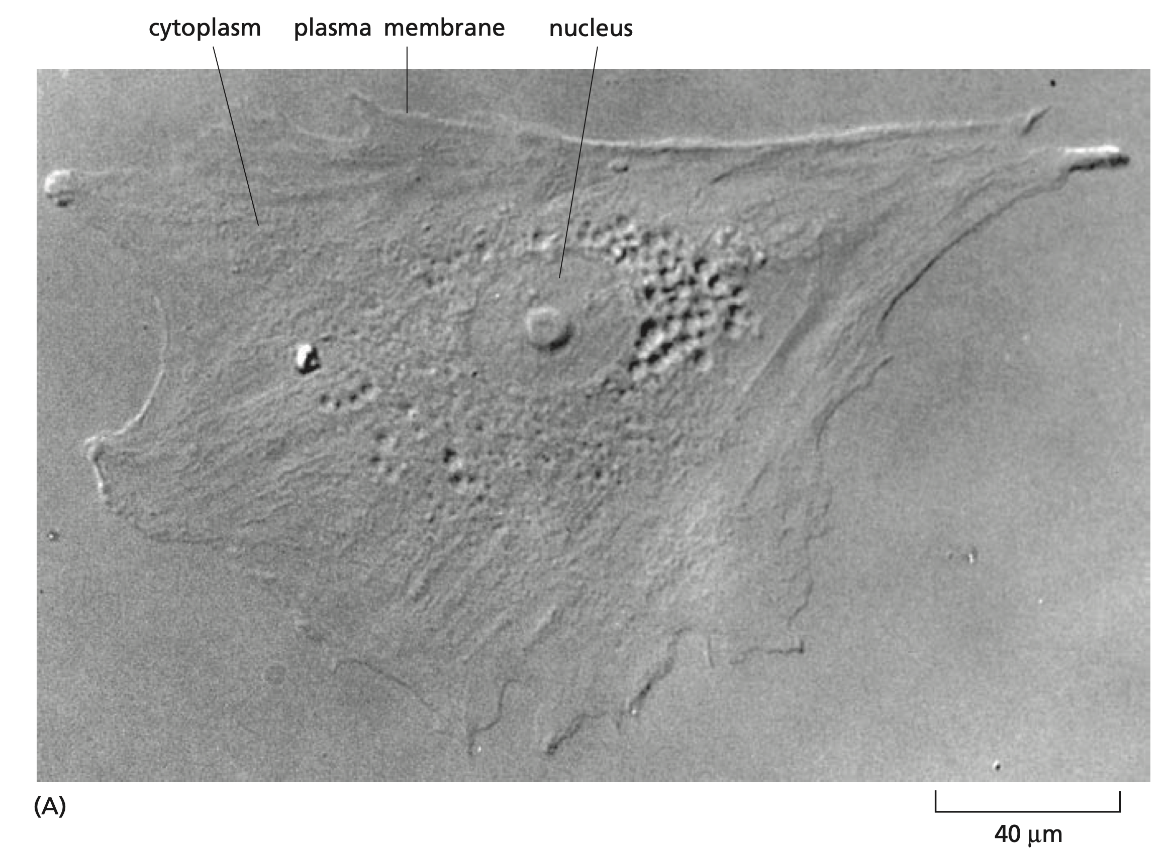
Light Microscope
Notes:
Human skin

Slide 49

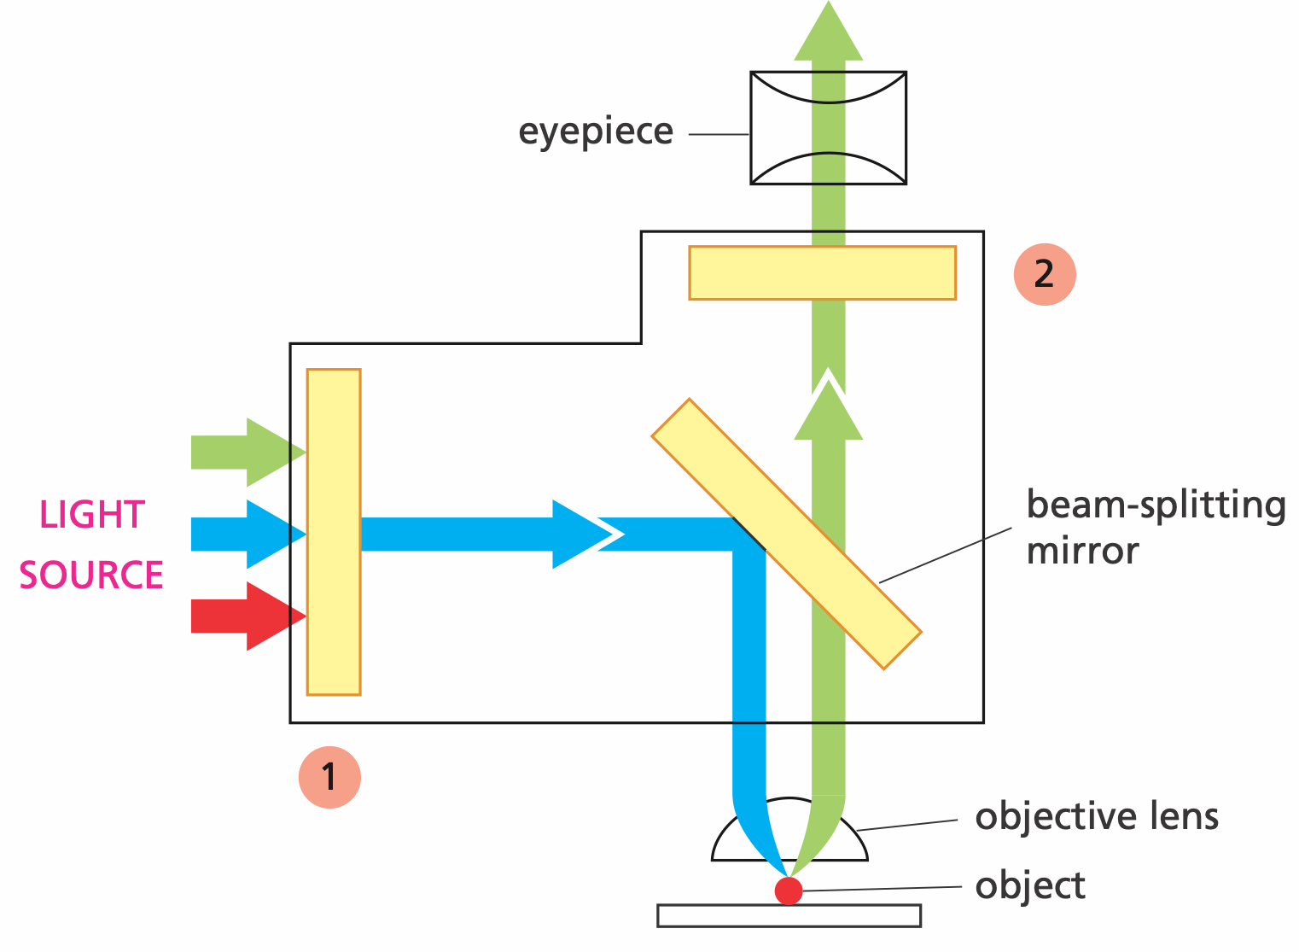
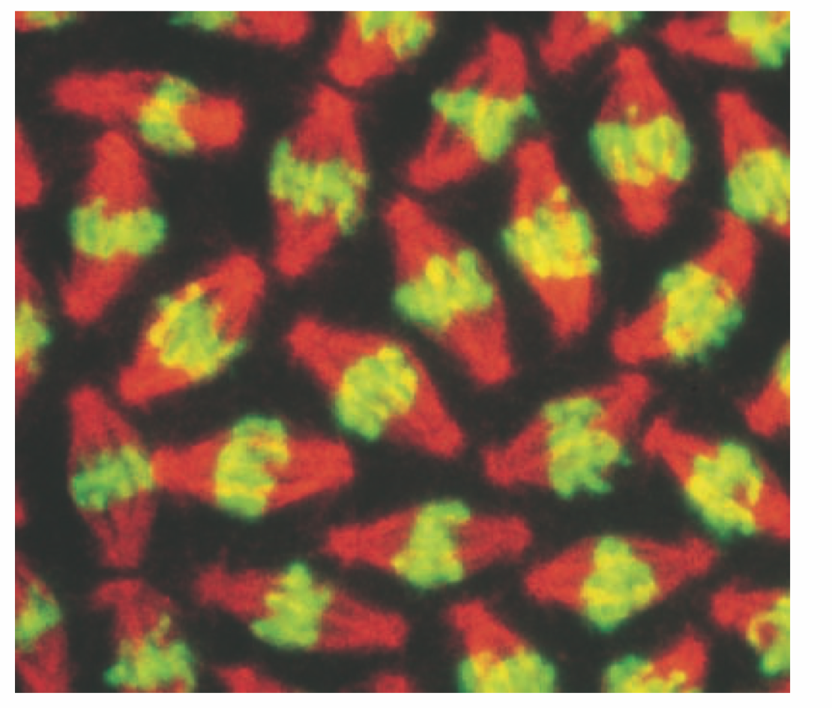
Fluorescence Microscopy

Slide 50
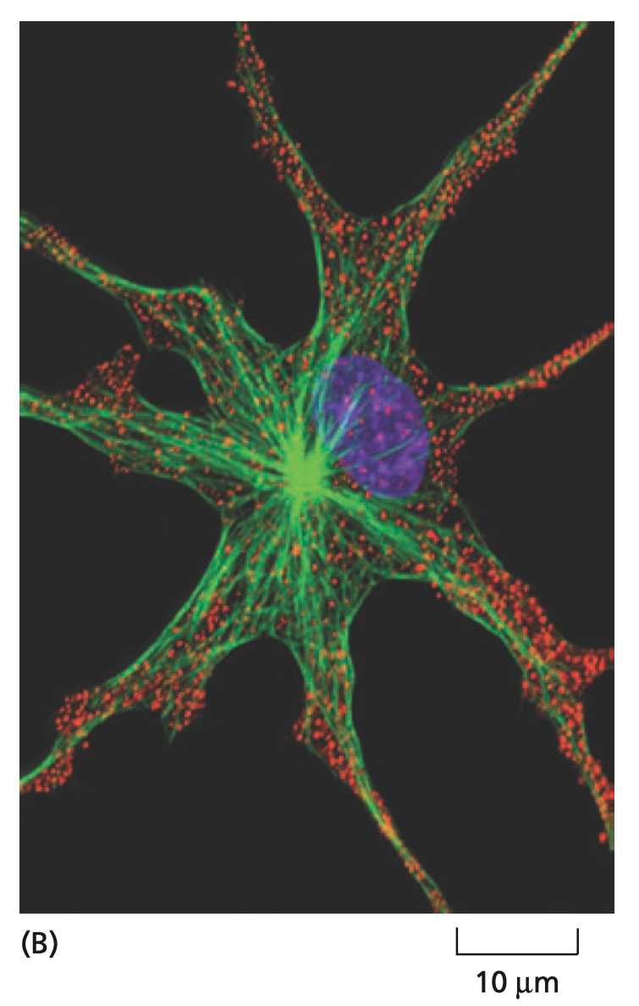
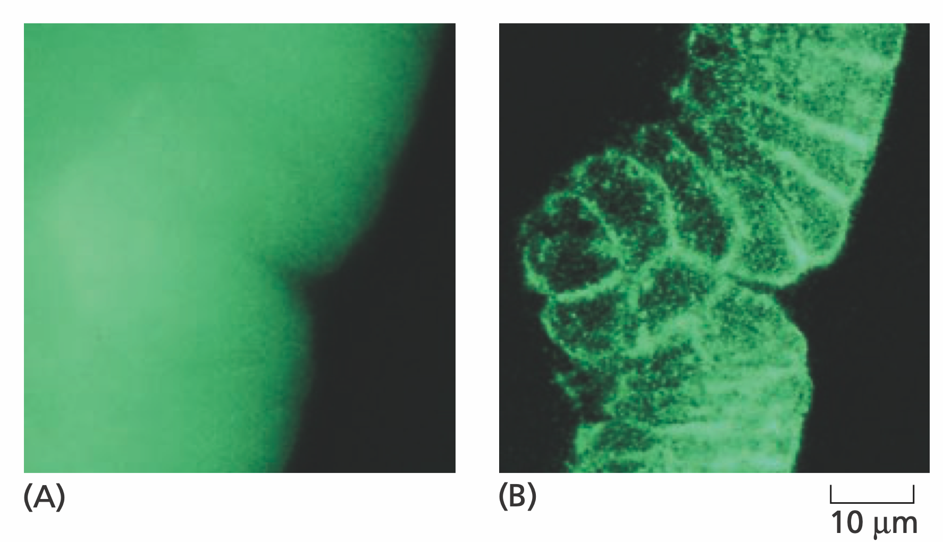
Confocal Microscopy
Notes:
Insect embryo, A: Fluorescent microscopy, B: Confocal
Right: Frog pigment cell, nucleus: blue, pigments: red, microtubules: green

Slide 51
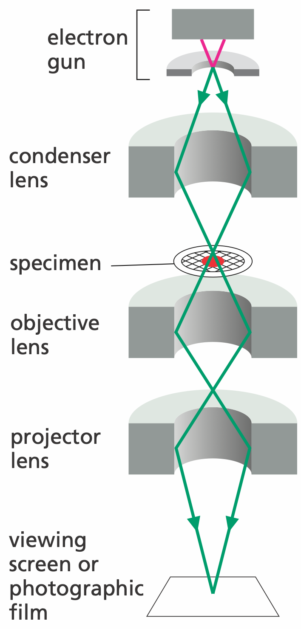
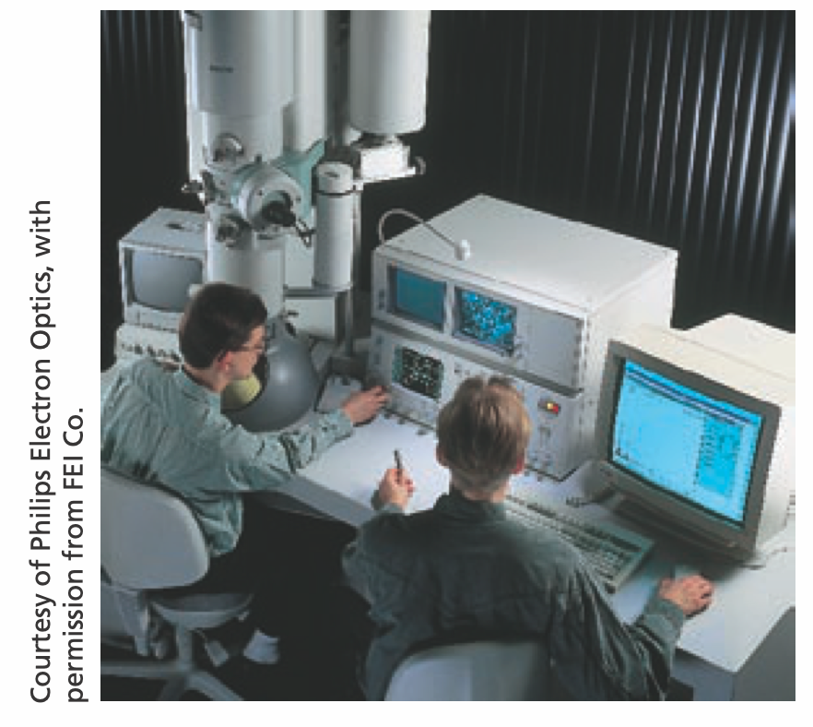
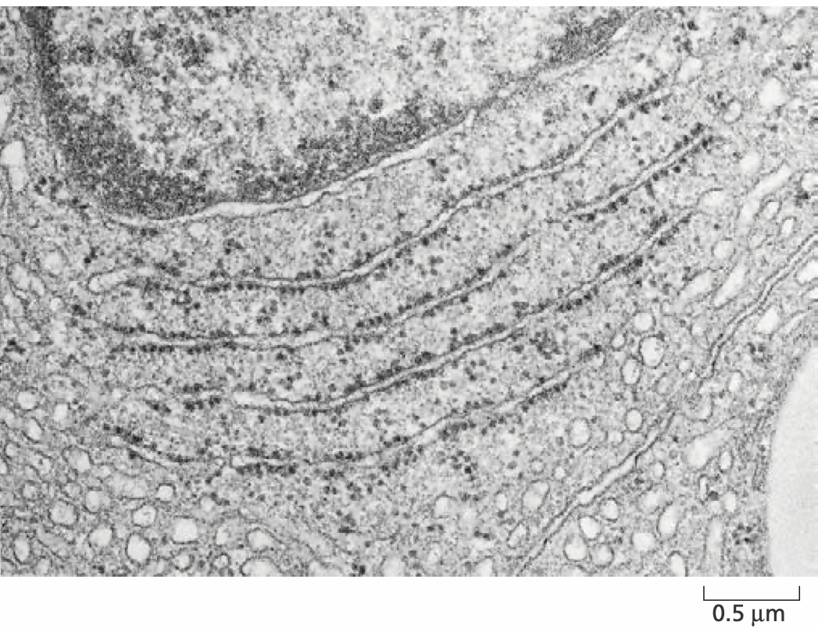
Transmission Electron Microscopy
Notes:
A section of testis

Slide 52
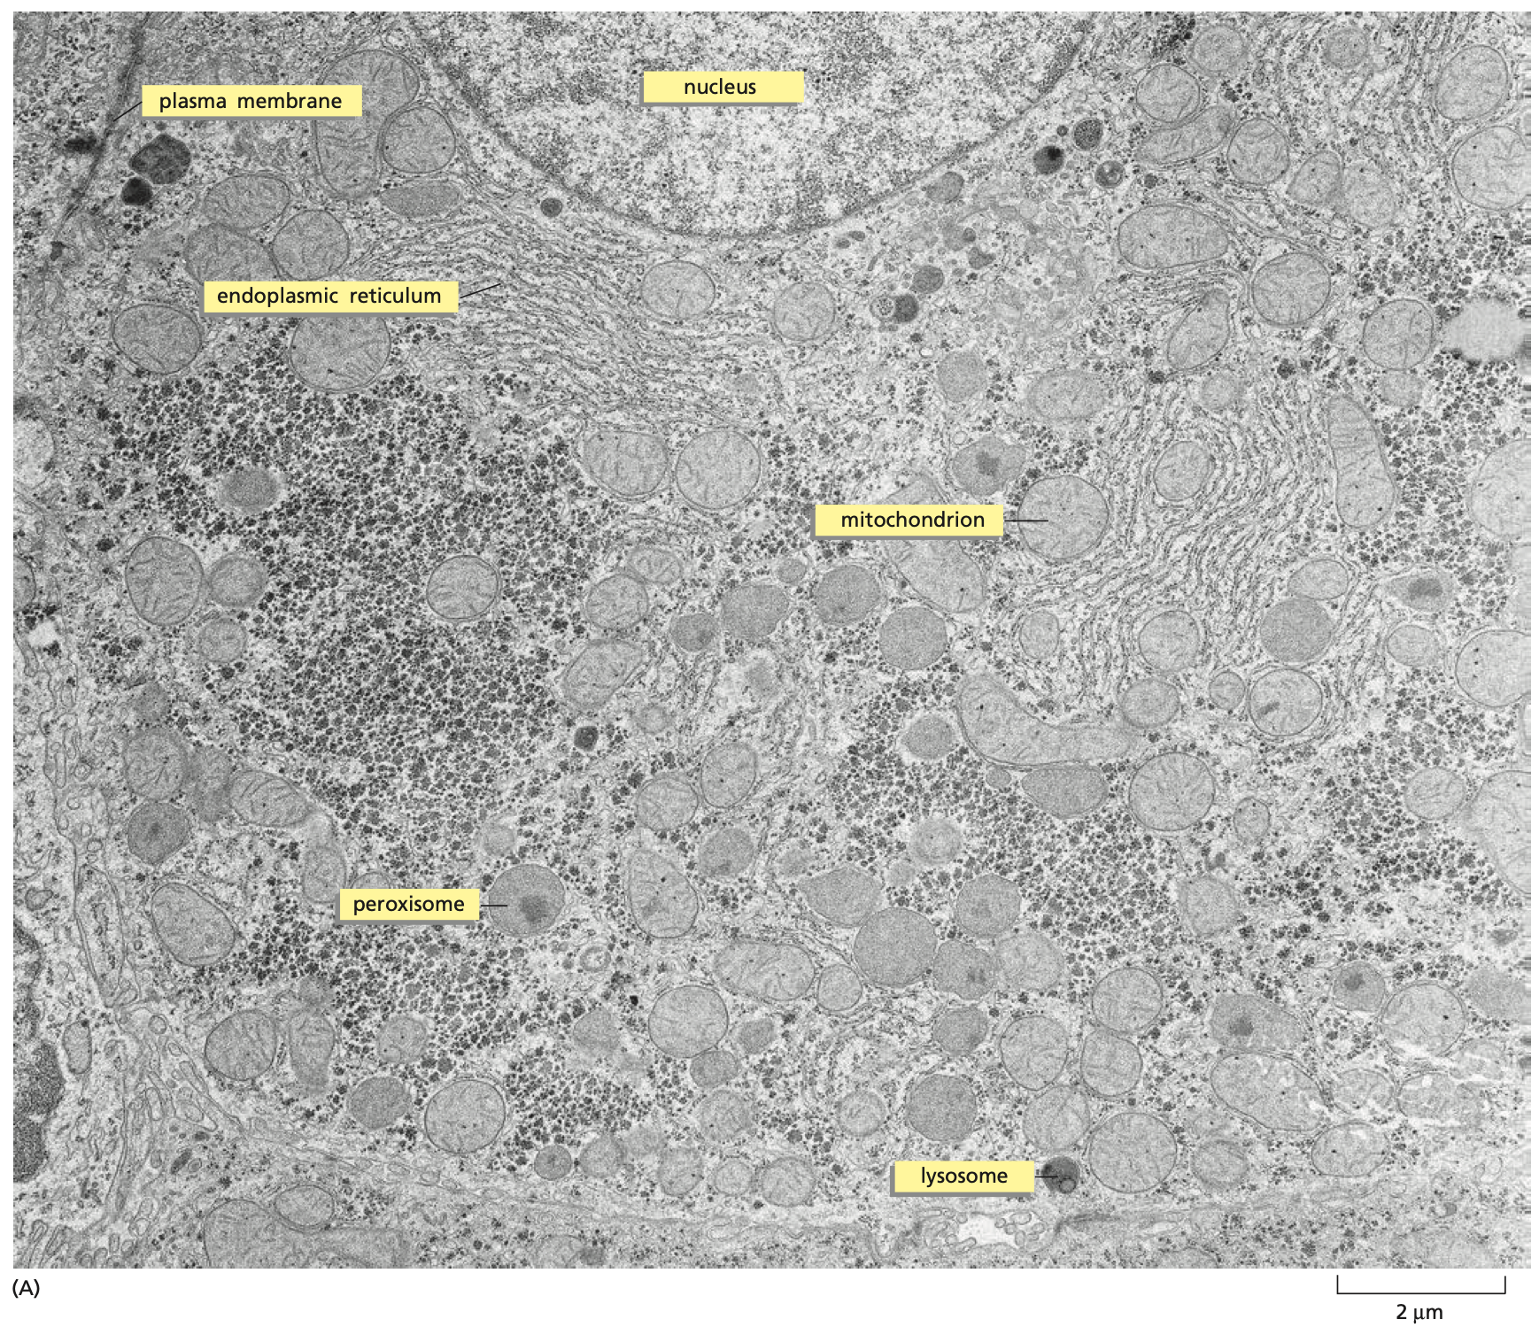
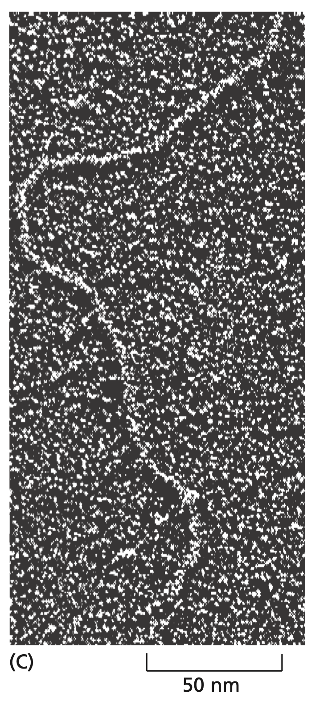
Transmission Electron Microscopy
Notes:
Left: Liver cell section
Right: DNA

Slide 53
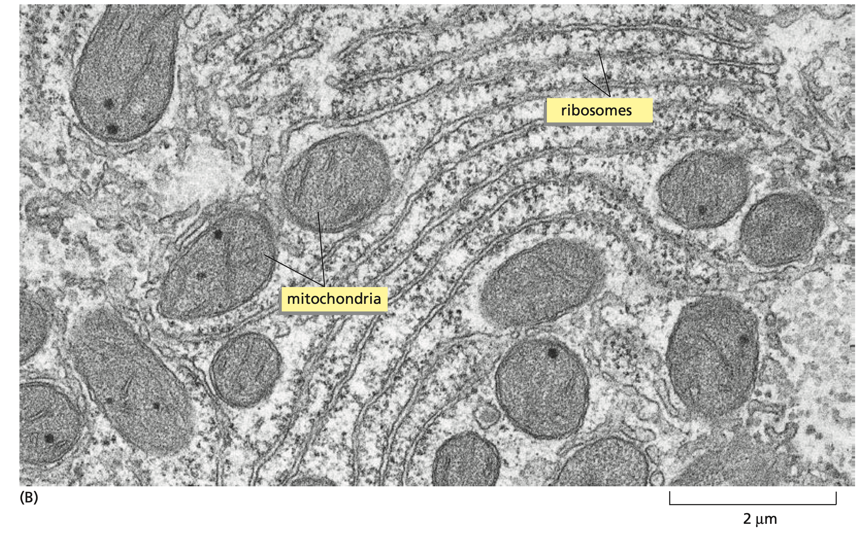
Transmission Electron Microscopy
Notes:
Small region of cytoplasm, Ribosomes: 80~90 molecules

Slide 54
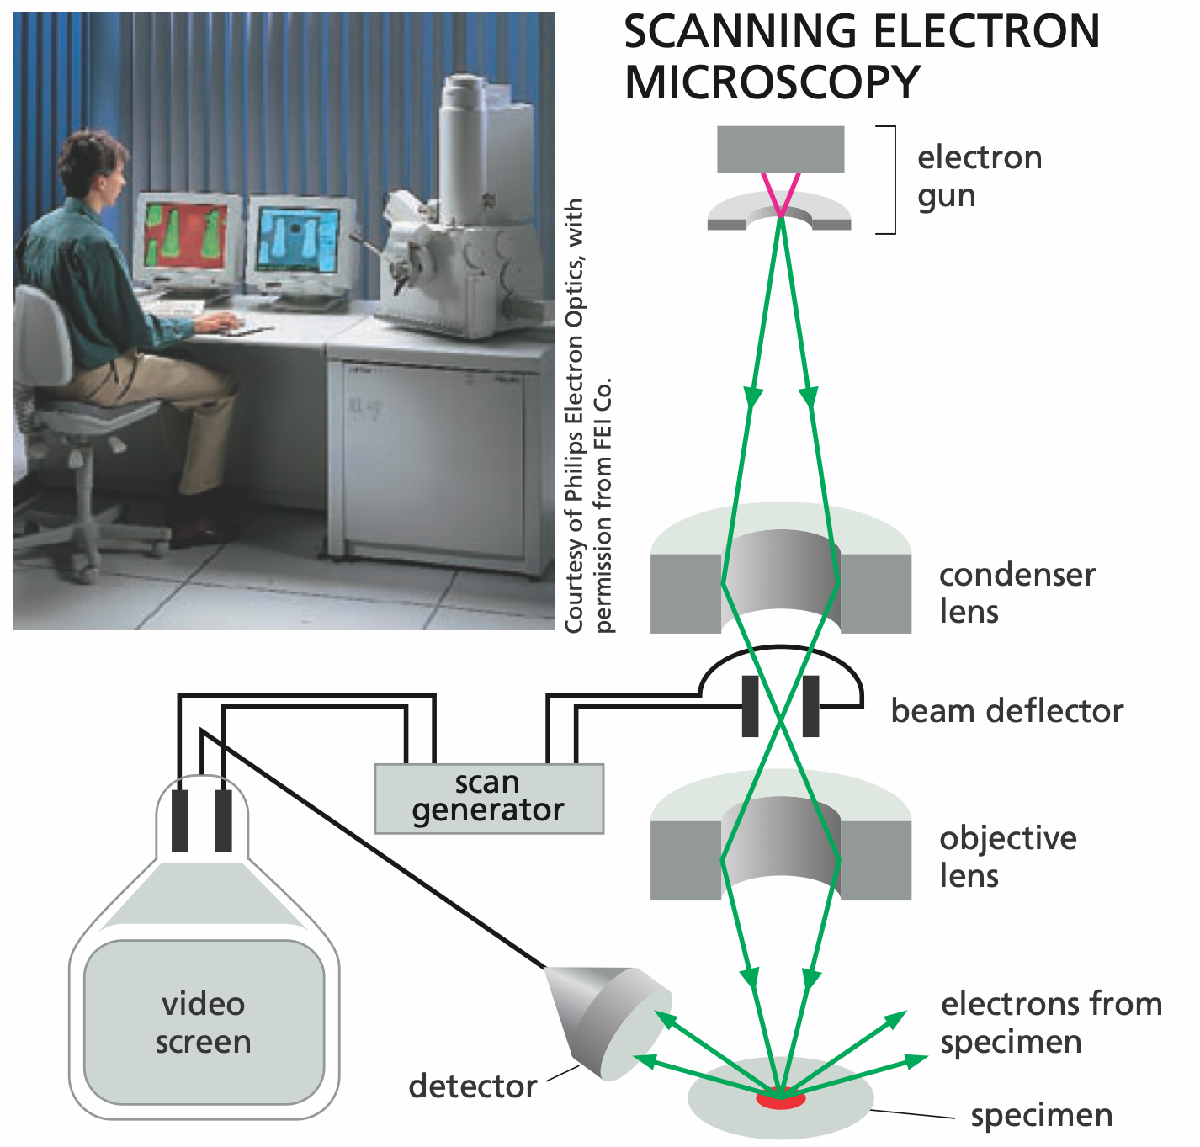
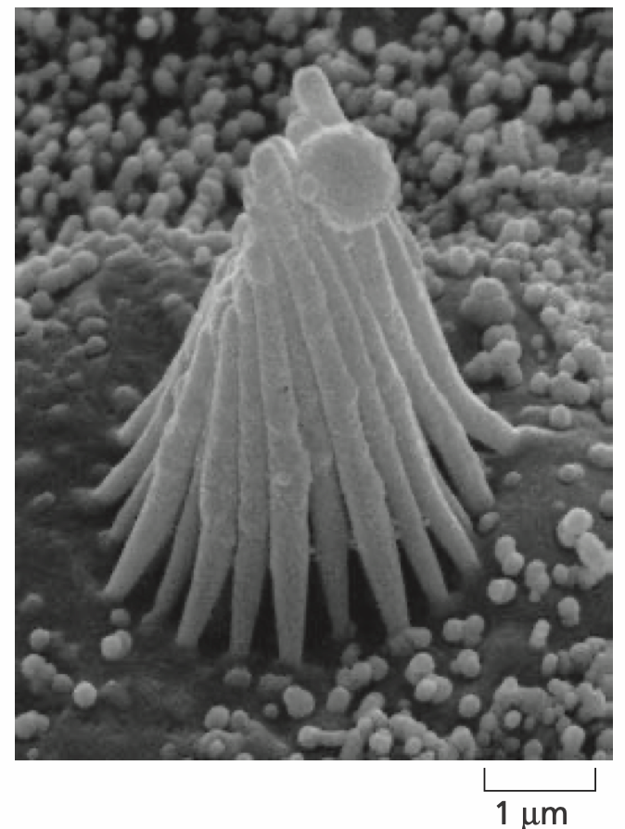
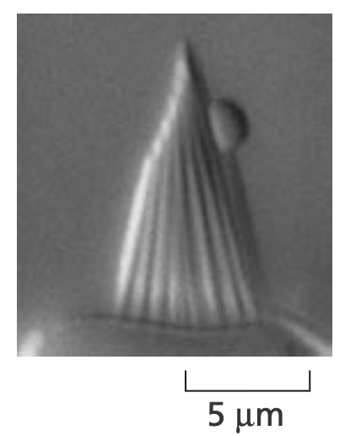
Scanning Electron Microscopy
Notes:
Left: light microscopy, right: SEM, Hair cells of inner ear

